Slide 1
AWS Cloud Practitioner Training Materials

Slide 2



Introduction
The AWS Cloud
Detailed overview of core concepts

Slide 3

Course Objectives
Define the AWS Cloud
Describe the key services on the AWS platform
P Common use cases
Describe basic AWS Cloud architectural principles Describe the AWS Shared Responsibility Model
P Basic security and compliance

Slide 4
Course Objectives Cont’d.
Define pricing models
Identify sources of documentation
P Whitepapers and AWS Documentation
Describe the AWS Cloud value proposition
Define characteristics of deployment/operation in the AWS Cloud

Slide 5
Course Outline
Course Overview
Module 1: AWS Cloud Concepts Module 2: AWS Core Services Module 3: AWS Security
Module 4: AWS Architecting Module 5: AWS Pricing Course Summary

Slide 6

Module 1
Introduction to:
Cloud
The AWS cloud

Slide 7
Module 2
AWS Core Services
Overview of Services and Categories Introduction to:
P The AWS Global Infrastructure
P Amazon VPC
P Security Groups
P Amazon EC2
P Amazon Elastic Block Store
P Amazon S3
P AWS Database Solutions

Slide 8
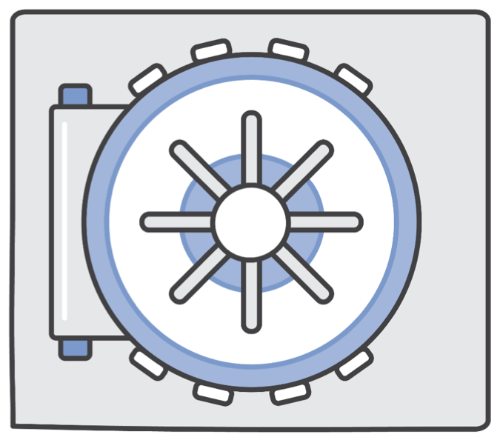
Module 3
AWS Security
Introduction to AWS Security
The AWS Shared Responsibility Model AWS Access Control and Management
AWS Security and Compliance Programs AWS Security Resources

Slide 9
Module 4
AWS Architecting
Introduction to the AWS Well-Architected Framework
Reference Architecture
P Fault Tolerance and High Availability
P Web Hosting

Slide 10

Module 5
AWS Pricing and Support Fundamentals of AWS Pricing Pricing Details for
P Amazon EC2
P Amazon S3 P Amazon EBS P Amazon RDS
P Amazon CloudFront
The TCO Calculator Overview AWS Support Plans Overview

Slide 11

Module 1: Cloud Concepts Overview

Slide 12



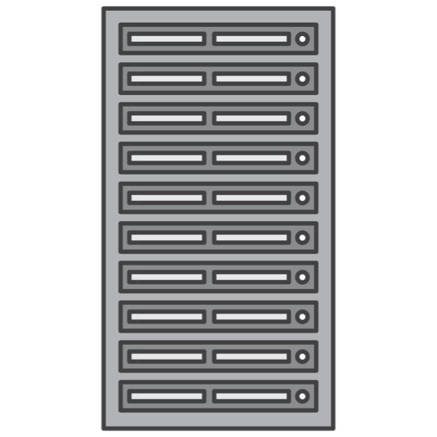
Introduction to the AWS Cloud
Cloud Computing
P On-demand delivery of IT resources and applications via the internet with pay-as-you-go pricing

Slide 13
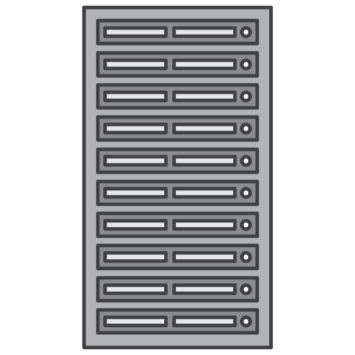
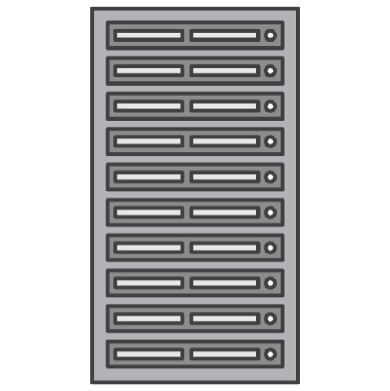
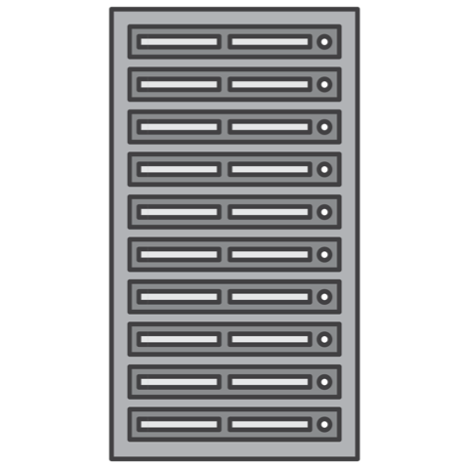

Before AWS
Guessing theoretical maximum peaks?
P Is there enough resource capacity?
P Is this sufficient storage?

Slide 14


With AWS
With AWS:
P Servers
P Databases
P Storage
P Higher-level applications

Slide 15
With AWS
Resources can be:
P Initiated within seconds
P Treated as “temporary and disposable”
Free from the inflexibility and constraints

Slide 16
Agility
3 factors:
Speed Experimentation Culture of innovation

Slide 17

Agility: Increase Speed and Global Reach
Instant global reach
Rapid availability of new resources

Slide 18

Agility: Increase Experimentation
AWS enables
P Operations as code
P Safe Experimentation
P Comparative testing

Slide 19
Agility: Increase Innovation
Quick experimentation with low cost/risk More experimentation and more often

Slide 20

Agility: The AWS Infrastructure
Instant elasticity Scalability Flexible Reliability Secure

Slide 21

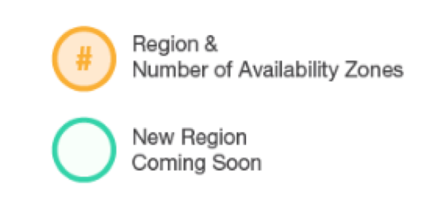
Regions and Availability Zones
3 ₃
3
3 ₃
3
2
6
3
3
₂ 2
2
4
1
2
3
Region & Number of AZs
3
3

Slide 22


Edge Locations
Edge Locations Multiple Edge Locations
Regional Edge Caches

Slide 23
High Availability
High availability:
P Functional and accessible systems
P Minimized downtime
P No human intervention

Slide 24
Fault Tolerance
Fault Tolerance:
P Operational applications during component failure
P Built-in redundancy of components

Slide 25
Elasticity, Scalability, and High Performance
AWS
Elastic infrastructure
Innovative new services/products Deployment in multiple regions
P Lower latency
P Better customer experience

Slide 26
Elasticity, Scalability, and High Performance
Customer
Use services at your own pace Use tools to meet your needs Adapt your consumption
P Scale up as workload grows
P Shutdown unneeded resources
P Use Auto Scaling

Slide 27


Security and Compliance
You retain control over region where data is located Security auditing
Periodic and manual
AWS cloud offer capabilities
For governance
To meet the strictest security requirements

Slide 28



Security and Compliance
Latest electronic surveillance
Multi-factor access control systems Trained security guards 24/7
Strict least-privileged access Environmental systems Multiple regions and Availability Zones

Slide 29

Reliability
High-performing and reliable solutions Achieve greater flexibility/capacity Reliability:
P Recover from failures
P Resources that demand and mitigate disruptions
Must have well-planned foundation
P Reduce uncertainty of forecasting
P Detect failure and automatically heal itself
Unmatched by on-premise solutions

Slide 30

Pricing: Pay as you go
Benefits
P Redirect focus to innovation and invention
P Adapt to changing business needs
P Improve responsiveness to changes
P Reduce risk or overprovisioning or missing capacity

Slide 31





Conclusion
Connect with customers
Develop ground-breaking new insights
Scientific breakthroughs
Deliver innovative new products and services

Slide 32
Module 2: AWS Technology Overview

Slide 33
Topics
AWS Global Infrastructure
Amazon Virtual Private Cloud (VPC) Security groups
Compute Services
Amazon Elastic Compute Cloud (EC2)
Elastic Load Balancing (ELB)
Auto Scaling
Amazon Elastic Block Store (EBS)
Amazon Simple Storage Service (S3)
Amazon Relational Database Service (RDS)
Amazon DynamoDB

Slide 34
AWS Global Infrastructure

Slide 35
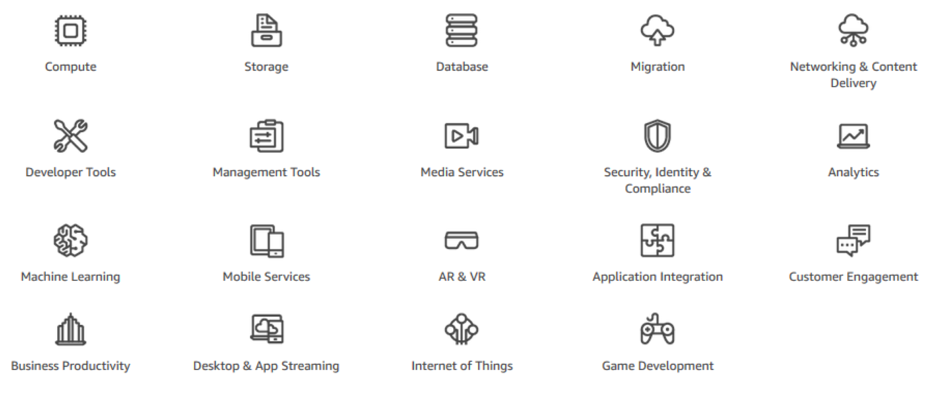
Introduction to Services and Categories

Slide 36
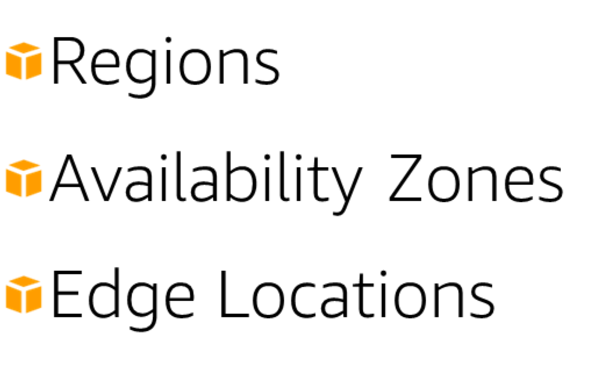
AWS Global Infrastructure
3 ₃
3
3 ₃
3
2
6
3
3
₂ 2
2
4
1
2
3
3
3

Slide 37
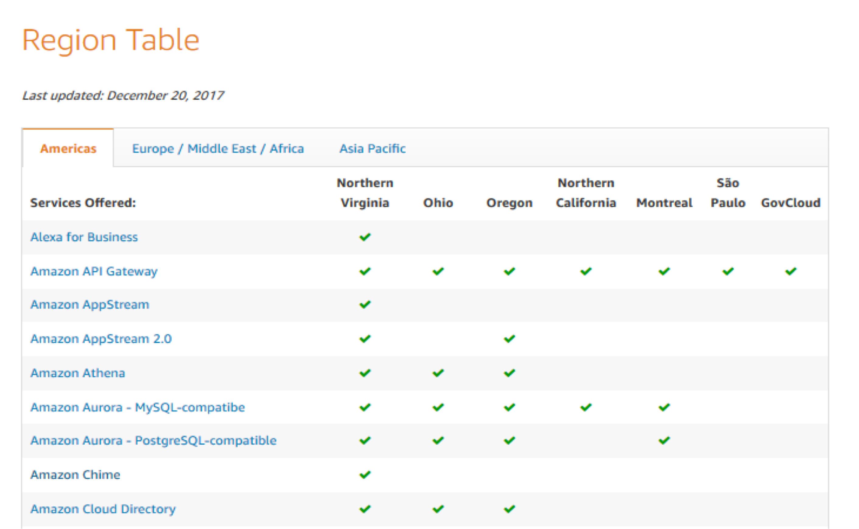
AWS Region Table

Slide 38
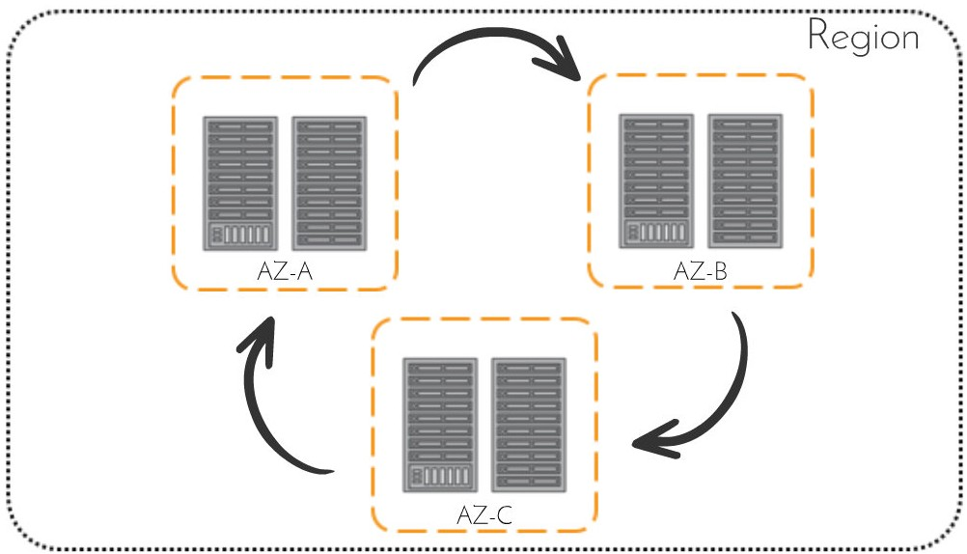
Availability Zones
Region
Physically distinct
Own uninterruptible power supply
Cooling equipment
Networking connectivity
Backup generators

Slide 39
Availability Zones
Isolating Availability Zones Protects zones from failure Designed for high availability
Handles requests through other zones
Best practice: Implement multiple Availability Zones

Slide 40
Edge Locations
Amazon CloudFront Amazon Route 53 AWS Shield
AWS Web Application Firewall Lambda@Edge Computing

Slide 41
Amazon Virtual Private Cloud (VPC)

Slide 42
Introduction
Private, virtual network in the AWS Cloud Similar constructs as on-premises network
Customizable network configurations to your needs

Slide 43
Deployment
Layer security controls in deployment
Multiple AWS services that inherit the security deployed

Slide 44















Introduction
Amazon EC2
Amazon EMR
Amazon RDS
Amazon WorkSpaces
Elastic Load Balancing
Amazon VPC
AWS
OpsWorks
Amazon EFS
AWS Elastic Beanstalk
Amazon Route 53
AWS
Data Pipeline
Amazon S3
Amazon DynamoDB
Amazon ElastiCache
AWS Directory Service

Slide 45
Features
Characteristics
P Allows you to provision virtual networks
Logically isolated Configurable key features
P IP ranges
P Routing
P Network gateways
P Security settings
Route Tables
P Control traffic going out of the subnets

Slide 46

Example
Test- VPC 10.0.0.0/16
10.0.0.0/24
Subnet A1
10.0.2.0/23
Subnet B1
Availability Zone A
us-west-2 (Oregon)

Slide 47



Example
Test- VPC 10.0.0.0/16
10.0.0.0/24
Test- IGW
Public Subnet A1
10.0.1.0/24
Private Subnet B1
Availability Zone A
us-west-2 (Oregon)

Slide 48
Summary
You created:
P VPC in the Oregon region
P An internet gateway
P One public subnet
P One private subnet
Learn More
P Route tables and isolation methods
P Other Amazon VPC features (e.g., VPC endpoints and peering connections)
P Security groups
P Amazon Elastic Cloud Compute (EC2)
P Amazon Relational Database Service (RDS)

Slide 49
AWS Security Groups

Slide 50

AWS Security
Is the highest priorities Security groups
P Act as built-in firewalls
P Control accessibility to instances

Slide 51





AWS Security
Corporate Admin Network
ssh/rdp
ssh/rdp
ssh/rdp
www server
app server
db server
db server
www server
app server
internet
http/https
www server
app server
db server
api
api
Web Tier
security group
Application Tier
security group
Database Tier
security group
(all other ports are blocked)

Slide 52
Summary
Amazon EC2 Security groups
P Provide virtual firewalls
P Control access to instances through rules
P Are managed through AWS management console

Slide 53
Compute Services

Slide 54
Compute Services
Broad catalog
P Application services
P Virtual private servers
P Serverless computing

Slide 55
Compute Services
AWS
P Flexible
P Cost effective
Amazon EC2
P Flexible configuration and control
AWS Lambda
P Pay only for what you use
P No administration

Slide 56
Compute Services
Amazon Lightsail
P Launch virtual private server
P Manage simple web and application servers
Amazon ECS
P Managed containers
P Highly scalable, high performance
AWS Fargate Amazon EKS

Slide 57
Amazon Elastic Compute Cloud (EC2)

Slide 58

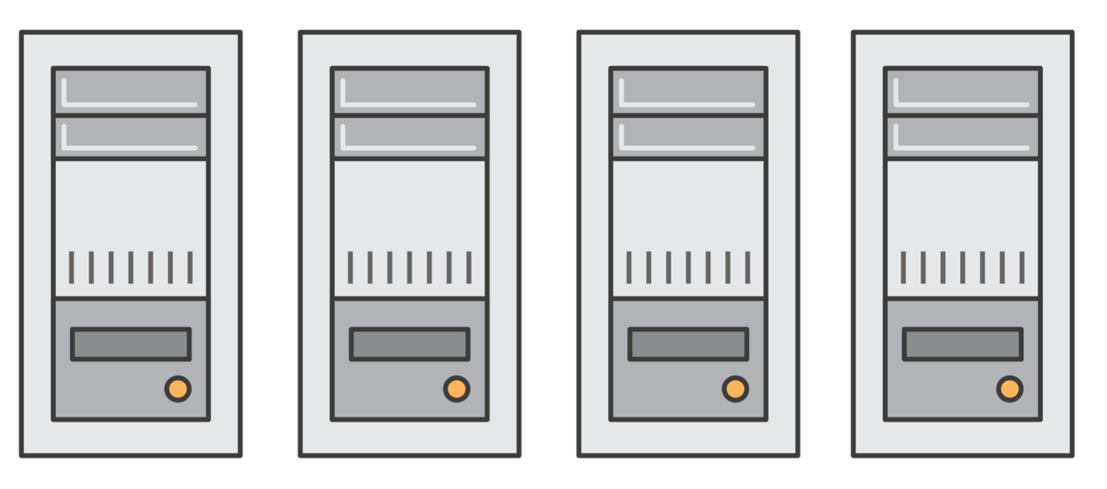
What is Amazon EC2?
Elastic Compute Cloud
Application Server
Web Server
Database Server
Game Server ü Mail Server ü Media Server
Catalog Server
File Server
Computing Server
Proxy Server

Slide 59













What is Amazon EC2?
Amazon EC2 Instances
Pay as you go
Broad selection of HW/SW Global hosting
Much more (aws.amazon.com/ec2)

Slide 60

Product Demonstration
Login to AWS console.
Launch EC2 Wizard.
Select AMI (SW).
Select Instance type (HW).
Configure network. ü Configure storage. ü Collect private key. ü Launch.
Connect.

Slide 61
Instance Types
Families | Description | Example Use Cases
t2, m4, m3 | General Purpose Balanced Performance | Websites, web applications, Dev, code repos, micro services, business apps
c3, c4, cc2 | Compute Optimized High CPU Performance | Front-end fleets, web-servers, batch processing, distributed analytics, science and engineering apps, ad serving, MMO gaming, video-encoding
g2, p2 | GPU Optimized High-end GPU | Amazon AppStream 2.0, video encoding, machine learning, high perf databases, science
r3, r4, x1, cr1 | Memory Optimized Large RAM footprint | In-memory databases, data mining
d2, i2, i3, hi1, hs1 | Storage Optimized High I/O, High density | NAS, data warehousing, NoSQL

Slide 62

Choosing the Right Amazon EC2 Instances
EC2 Instance types are optimized for different use cases, workloads & come in multiple sizes. This allows you to optimally scale resources to your workload requirements.
AWS utilizes Intel® Xeon® processors for EC2 Instances providing customers with high performance and value.
Consider the following when choosing your instances: core count, memory size, storage size & type, network performance, I/O requirements & CPU technologies.
Hurry Up & Go Idle - A larger compute instance can save you time and money, therefore paying more per hour for a shorter amount of time can be less expensive.

Slide 63

EC2 Instances Powered by Intel Technologies
EC2 Instance Type | Compute Optimized |  | General Purpose |  |  | Memory Optimized |  |  | Storage Optimized
 | C5 | C4 | M5 | M4 | T2 | X1 | X1e | R4 | H1 | I3 | D2
Intel Processor | Xeon Platinum 8175M | Xeon E5 2666 v3 | Xeon Platinum 8175M | Xeon E5 2686 v4 2676 v3 | Xeon Family | Xeon E7 8880 v3 | Xeon E7 8880 v3 | Xeon E5 2686 v4 | Xeon E5 2686 v4 | Xeon E5 2686 v4 | Xeon E5 2676 v3
Intel Processor Technology | Skylake | Haswell | Skylake | Broadwell Haswell | Yes | Haswell | Haswell | Broadwell | Broadwell | Broadwell | Haswell
Intel AVX | Yes | Yes | Yes | Yes | Yes | Yes | Yes | Yes | Yes | Yes | Yes
Intel AVX2 | Yes | Yes | Yes | Yes | - | Yes | Yes | Yes | Yes | Yes | Yes
Intel AVX-512 | Yes | - | Yes | - | - | - | - | - | - | - | -
Intel Turbo Boost | Yes | Yes | Yes | Yes | Yes | Yes | Yes | Yes | Yes | Yes | Yes
Storage | EBS-only | EBS-only | EBS-only | EBS-only | EBS-only | SSD EBS-Opt | SSD EBS-Opt | - | HDD | SSD | HDD

Slide 64



C5: Compute Optimized Instances
Based on 3.0 GHz Intel Xeon Scalable
Processors (Skylake)
Up to 72 vCPUs and 144 GiB of memory (2:1 Memory:vCPU ratio)
25 Gbps NW bandwidth Support for Intel AVX-512
25% price/performance improvement over C4
“We saw significant performance improvement on
Amazon EC2 C5, with up to a 140% performance improvement in industry standard CPU benchmarks over C4.”
“We are eager to migrate onto the AVX-512 enabled c5.18xlarge instance size… . We expect to decrease the processing time of some of our key workloads by more than 30%.”
C4 C5

Slide 65
M5: Next-Gen General Purpose instance
Powered by 2.5 GHz Intel Xeon Scalable Processors (Skylake)
New larger instance size—m5.24xlarge with
96 vCPUs and 384 GiB of memory (4:1 Memory:vCPU ratio)
Improved network and EBS performance on smaller instance sizes
Support for Intel AVX-512 offering up to twice the performance for vector and floating point workloads
14% price/performance improvement With M5
M4 M5

Slide 66
Elastic Load Balancing (ELB)

Slide 67
Introduction to Elastic Load Balancing
Managed load balancing service
Distributes loads between instances

Slide 68
Elastic Load Balancing Products
Application Load Balancer (ALB)
Network Load Balancer (NLB)
Classic Load Balancer (CLB)
HTTP HTTPS
TCP
PREVIOUS GENERATION for HTTP, HTTPS, and TCP
Flexible application management
Advanced load balancing of
HTTP and HTTPS traffic
Operates at the request level (Layer 7)
Extreme performance and static IP for your application
Load balancing of TCP traffic
Operates at the connection level (Layer 4)
Existing application that was built within the EC2-Classic network
Operates at both the request level and connection level

Slide 69
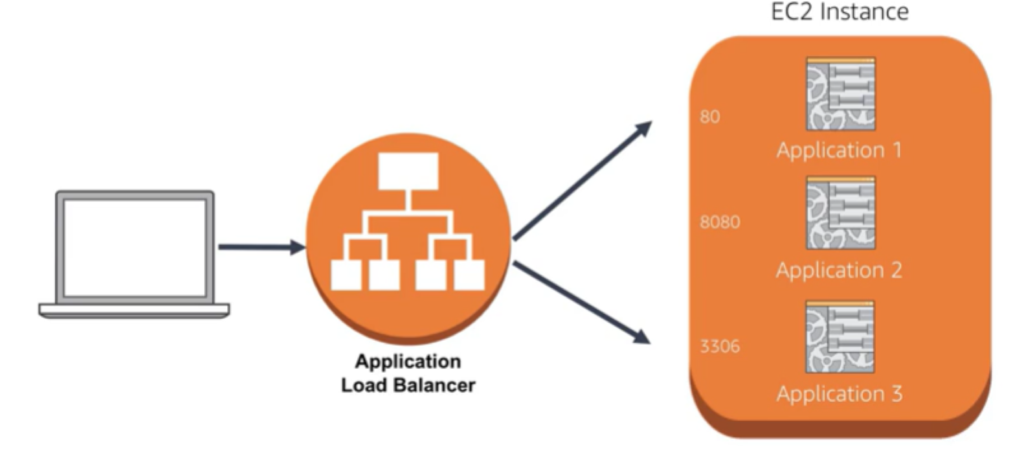
Application Load Balancer Use Cases
Application 1
Application 2
Application
Application 3
Load Balancer

Slide 70
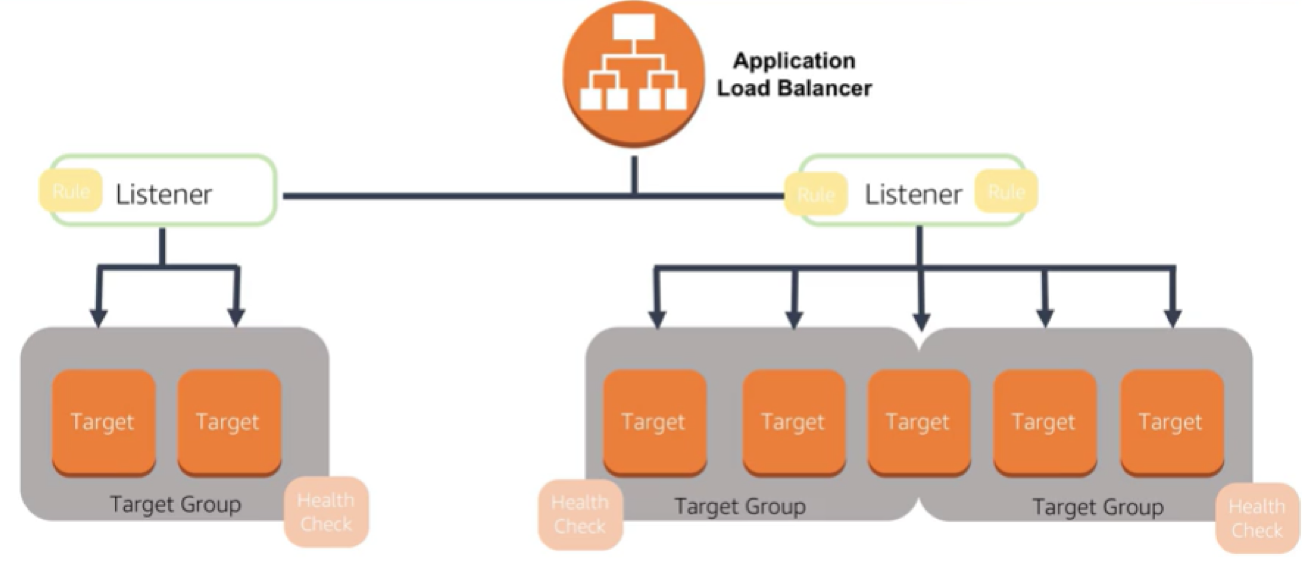
Application Load Balancer Use Cases
Application Load Balancer
Rule
Listener
Rule
Listener
Rule
Target Target
Target Group
Target Targe
t Target
Target Target
Health Check
Health Check
Target Group
Target Group
Health Check

Slide 71
Classic Load Balancer Use Cases
Access servers through single point Decouple the application environment Provide high availability and fault tolerance Increase elasticity and scalability

Slide 72
Network Load Balancer Use Cases
Sudden and volatile traffic patterns
Single static IP address per Availability Zone
Ideal for applications that require extreme performance

Slide 73
Summary
Managed load balancing service Application Load Balancer Network Load Balancer
Classic Load Balancer

Slide 74
Auto Scaling

Slide 75

What Is Auto Scaling?
Helps you verify that you have the desired number of Amazon EC2 instances available to handle the load for your application

Slide 76
Monitoring Resource Performance
Amazon CloudWatch to monitor performance
Auto Scaling to add or remove EC2 instances

Slide 77
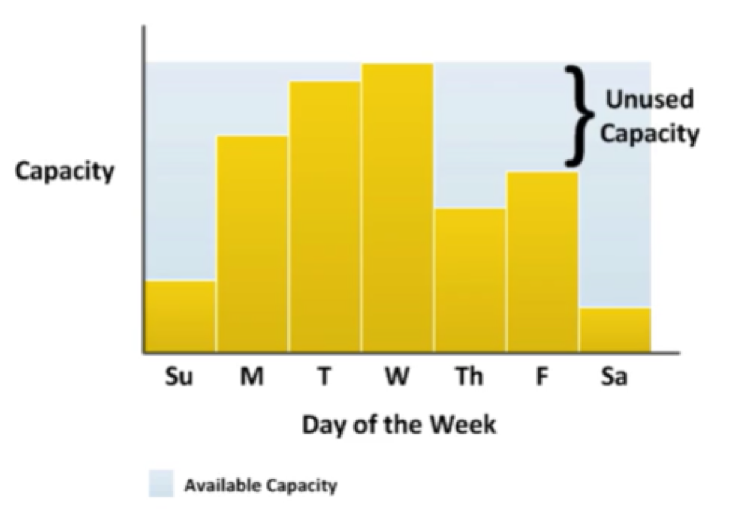
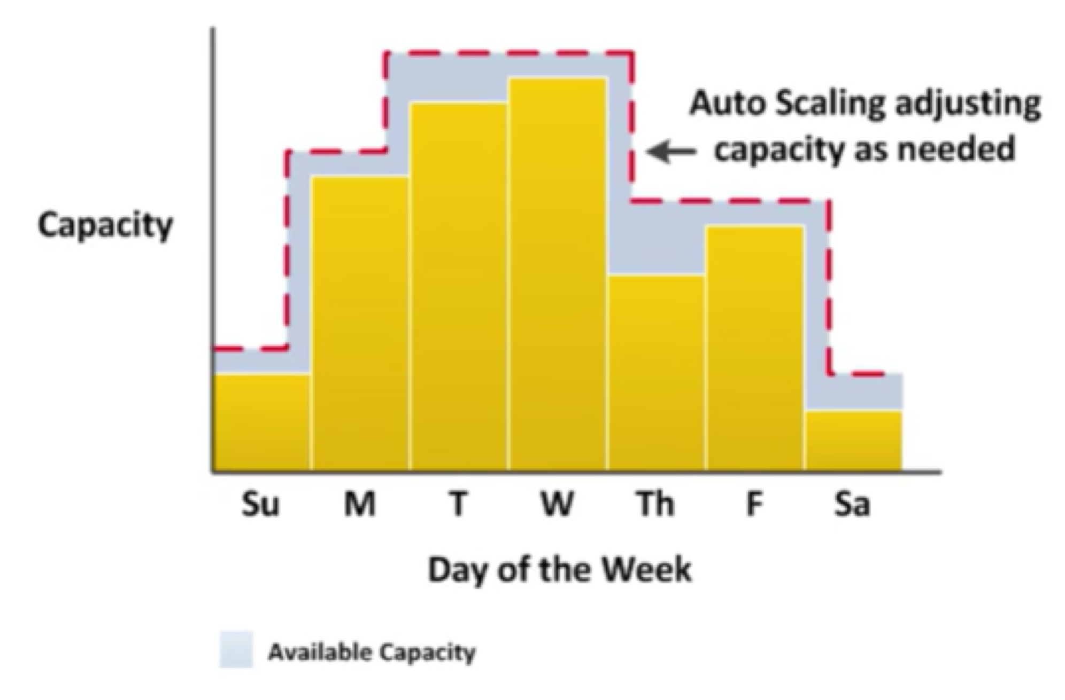


Capacity Management
}
Auto Scaling adjusting
← capacity as needed
Unused Capacity
Capacity
Capacit
y
Su M T W Th F Sa
Day of the Week
Su M T W Th F Sa
Day of the Week
Available Capacity
Available Capacity

Slide 78






Critical Questions
How can I make sure that my workload has enough EC2 resources to meet fluctuating performance requirements?
Scalability
How can EC2 resource provisioning occur on-demand?
Automation

Slide 79










Scaling Out and Scaling In
Elastic Load Balancing
Auto Scaling group
Auto Scaling group
Auto Scaling group
Base Configuration
Scaling Out Scaling In
Launch Instances Terminate Instances

Slide 80
Auto Scaling Components
Launch Configuration Auto Scaling groups Auto Scaling Policy

Slide 81
Auto Scaling Components
Launch Configuration: What will be scaled?
Launch settings
P AMI
P Instance type
P Security groups
P Roles

Slide 82
Auto Scaling Components
Auto Scaling Group: Where will it take place?
Deployment settings
P VPC and subnets
P Load balancer
P Minimum instances
P Maximum instances
P Desired capacity

Slide 83
Auto Scaling Components
Auto Scaling Policy: When will it take place?
Policy settings
P Scheduled
P On-demand
P Scale-out policy
P Scale-in policy

Slide 84
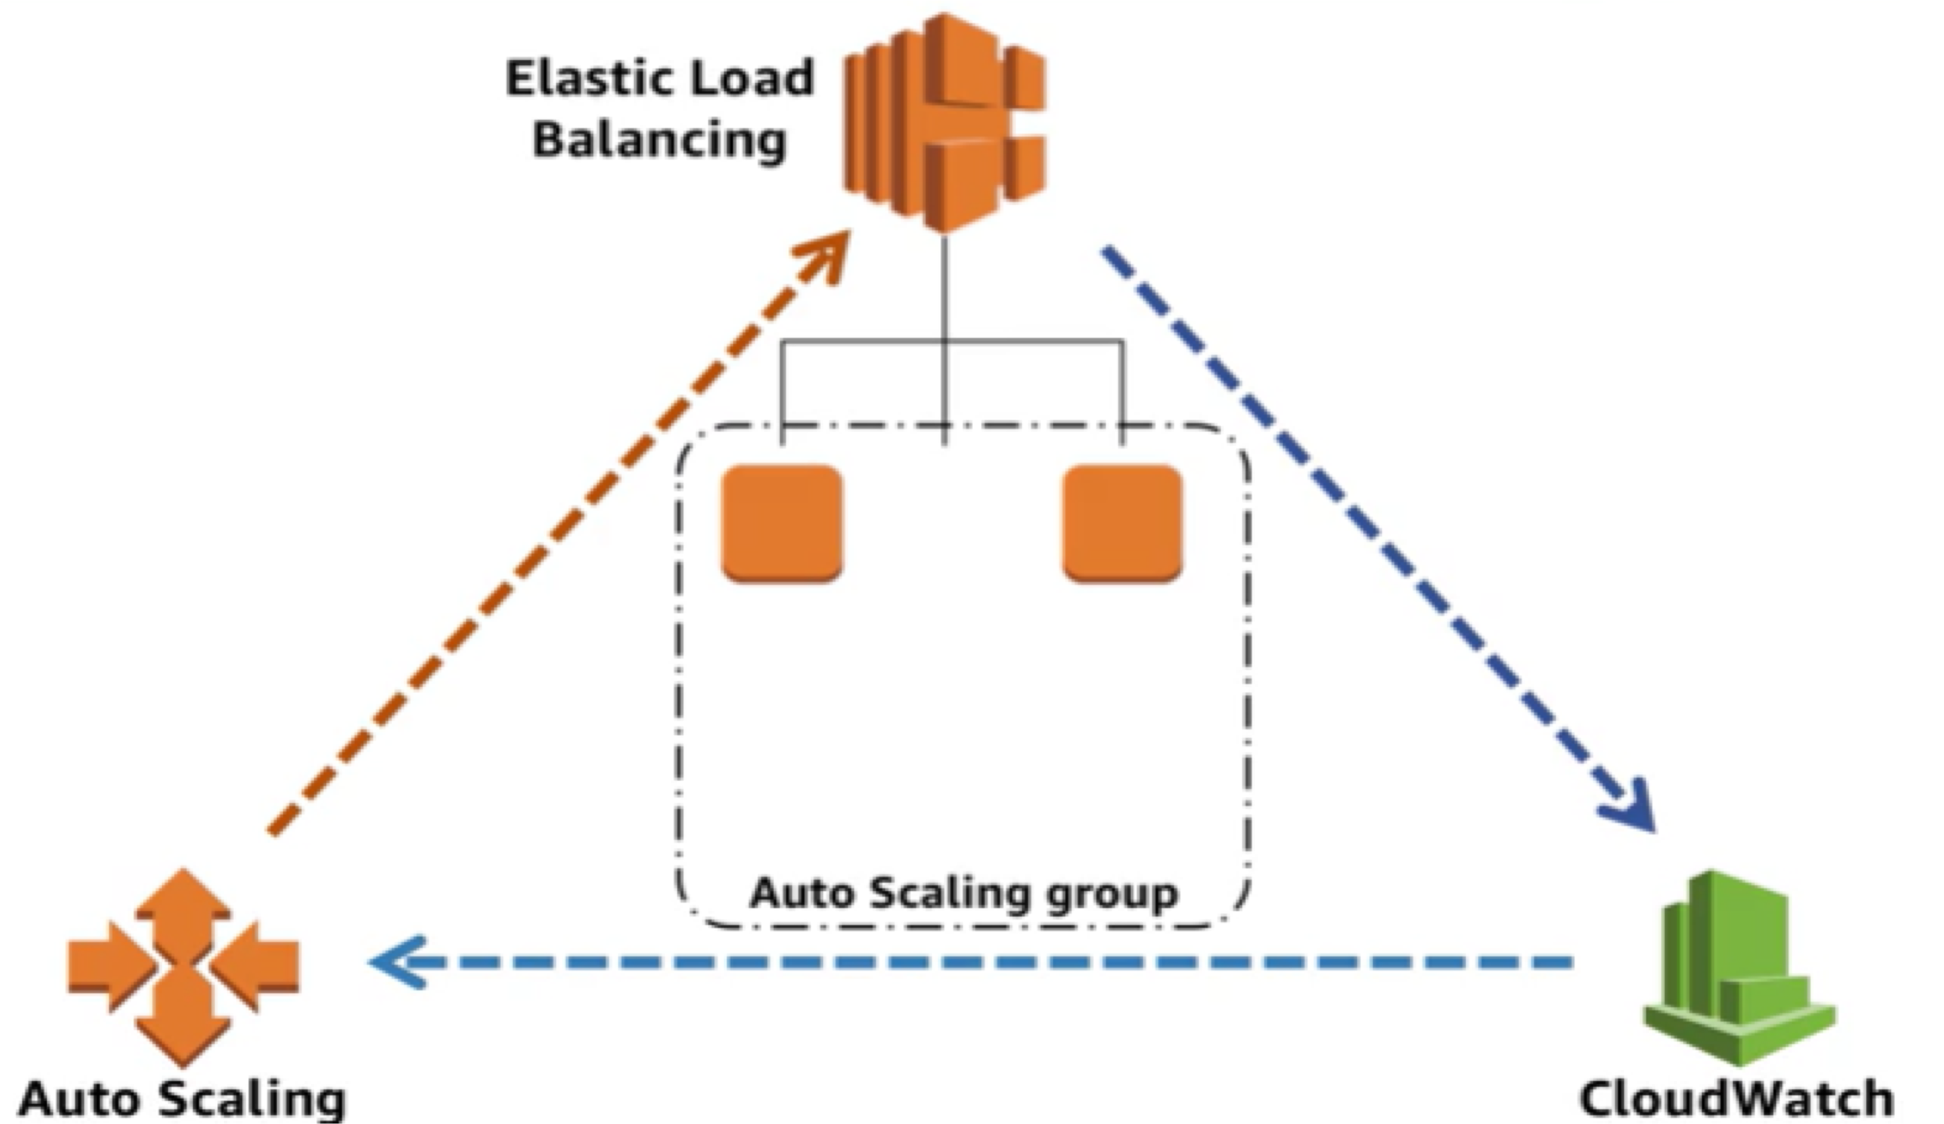
Dynamic Auto Scaling
Elastic Load Balancing
Auto Scaling group
Auto Scaling
CloudWatch

Slide 85
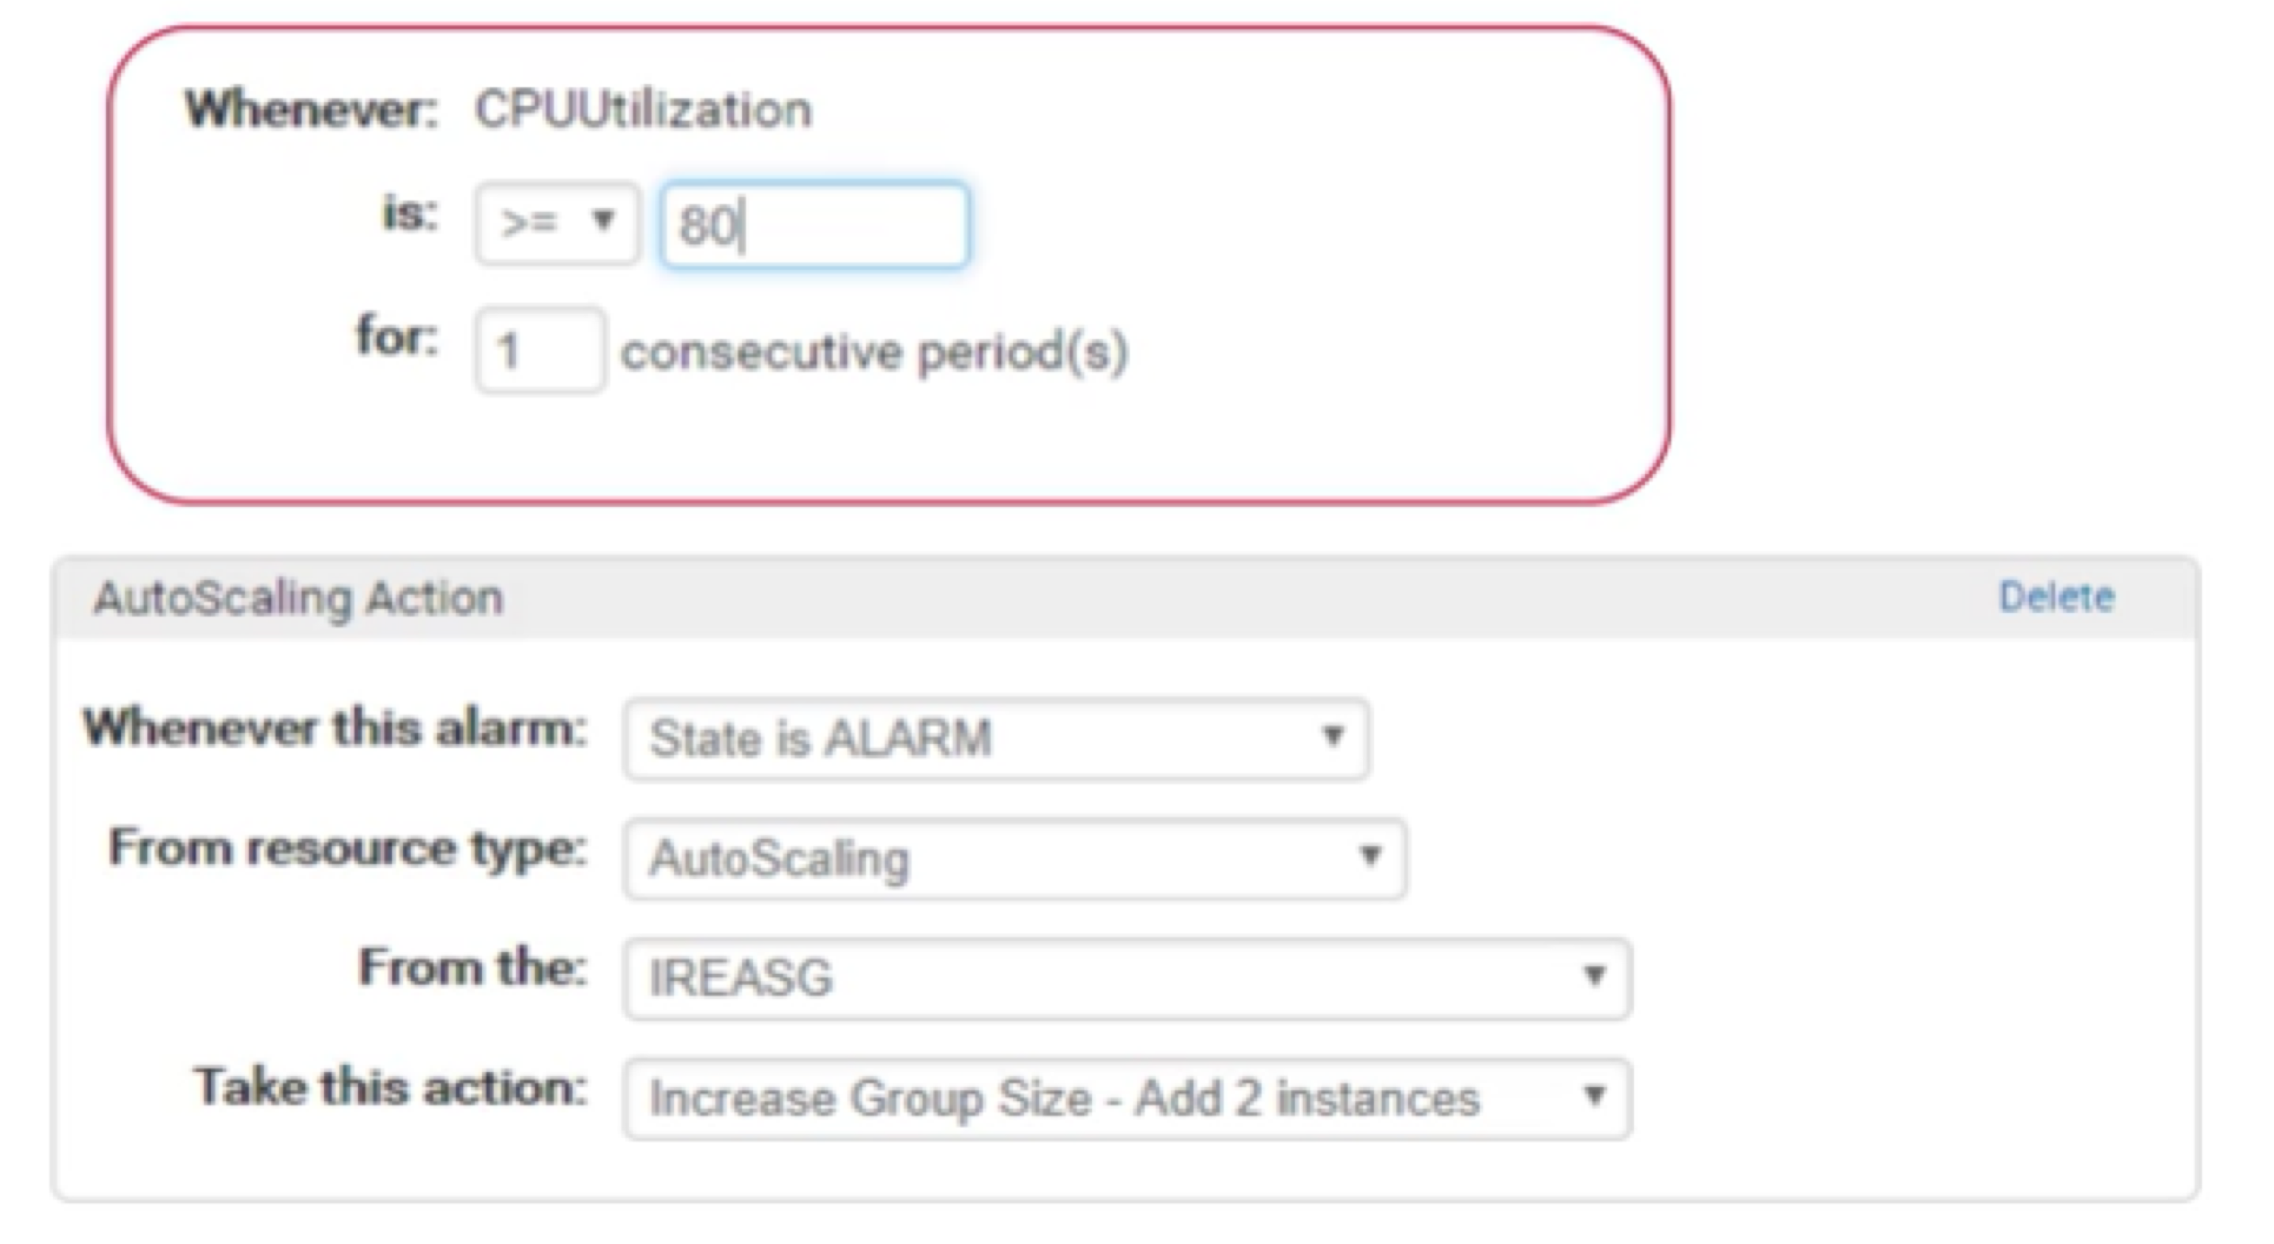

CloudWatch Alarm for Auto Scaling
Whenever: CPUUtilization
is: >= 80
for:
1
consecutive period(s)
AutoScaling Action
Delete
Whenever this alarm: State is ALARM
From resource type: AutoScaling
From the:
IREASG
Take this action:
Increase Group Size – Add 2 instances

Slide 86

Summary
Created
P A launch configuration
P Auto Scaling group
P Auto Scaling policy
Triggered Auto Scaling

Slide 87
Amazon Elastic Block Store (EBS)

Slide 88
EBS Volumes
Characteristics
Persistent and customizable block storage for EC2 instances HDD and SSD types
Use Snapshots for backups
Easy and transparent encryption Elastic

Slide 89
EBS Volumes
Availability
Durable and automatically replicated
Drive Types
Storage that best fits your needs Magnetic or SSD
Performance and price requirements

Slide 90



Amazon EBS
Snapshots
Point-in-time snapshots
Recreate a new volume at any time
Encryption
Encrypted EBS volumes No additional cost
Elasticity
Increase capacity
Change to different types

Slide 91
Summary
Features
P Persistent and customizable block storage for EC2 instances
P HDD and SSD types
P Replicated in the same Availability Zones
P Easy and transparent encryption
P Elastic volumes
P Back up using snapshots

Slide 92
Amazon Simple Storage Service (S3)

Slide 93
Amazon S3
Features
P Fully managed cloud storage service
P Rich security controls
Functionality
P Store virtually unlimited number of objects
P Access any time, from anywhere

Slide 94

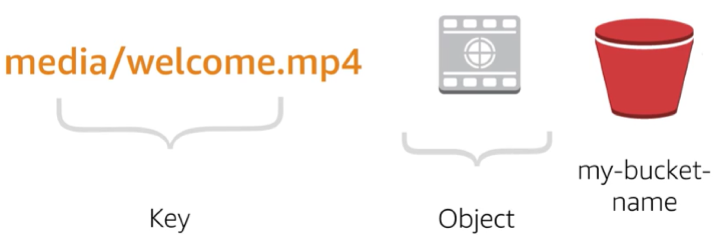
Getting Started with S3
media/welcome.mp4
my-bucket-name
media/welcome.mp4
Key
Object
my-bucket-name

Slide 95
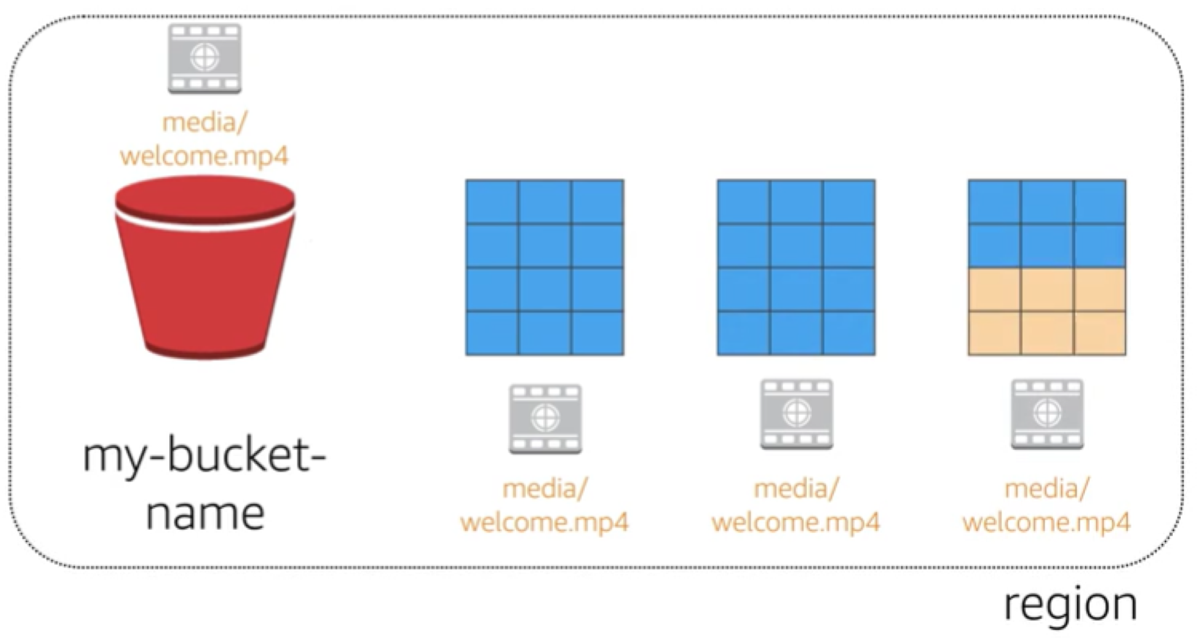
Data redundantly stored in region
media/welcome.mp4
my-bucket-name
media/welcome.mp4
media/welcome.mp4
media/welcome.mp4
region

Slide 96
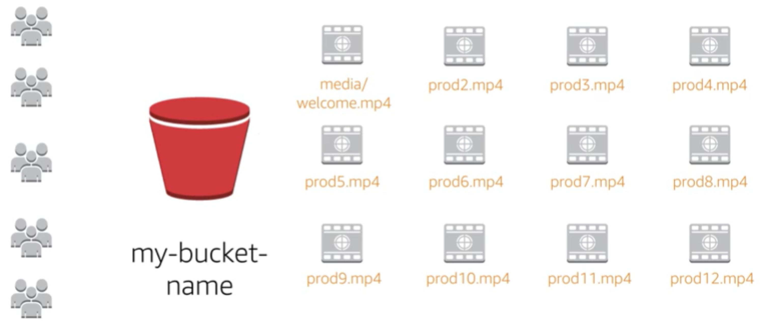
Designed for seamless scaling
media/welcome.mp4 prod2.mp4 prod3.mp4 prod4.mp4
prod5.mp4
prod6.mp4
prod7.mp4
prod8.mp4
my-bucket-name
prod9.mp4 prod10.mp4 prod11.mp4 prod12.mp4

Slide 97
Access the Data Anywhere
AWS Management Console AWS command line interface AWS software development kits

Slide 98
Common Use Cases
Storing application assets Static web hosting
Backup and disaster recovery (DR) Staging area for big data

Slide 99
Summary
Fully managed cloud storage service
Store virtually unlimited number of objects Access any time, from anywhere
Rich security controls
Common use cases

Slide 100
Amazon Relational Database Service (RDS)

Slide 101
Challenges of Relational Databases
Server maintenance and energy footprint Software installation and patches Database backups and high availability Limits on scalability
Data security
OS install and patches

Slide 102
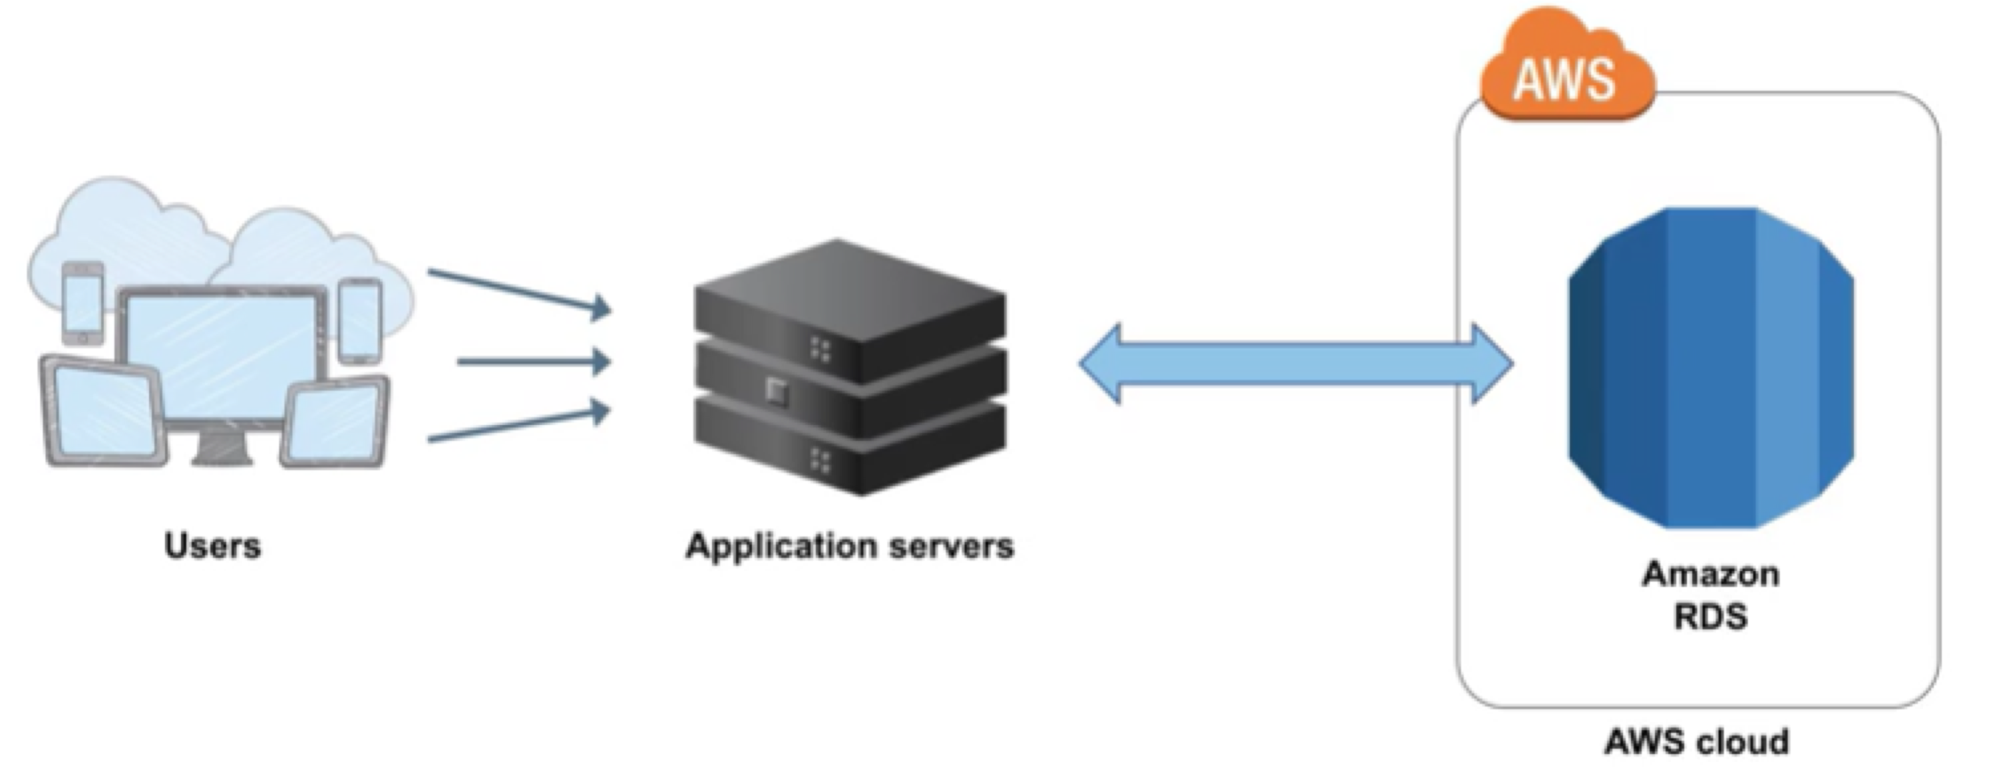
Amazon RDS
Managed service that sets up and operates a relational database in the Cloud
Users
Application
servers
Amazon RDS
AWS Cloud

Slide 103
Amazon RDS
Customer manages:
P Application Optimization
P Database schema
P Data
AWS manages:
P OS installation and patches
P Database software installation and patches
P Database backups
P High availability
P Scaling
P Power, rack and stack
P Server maintenance

Slide 104
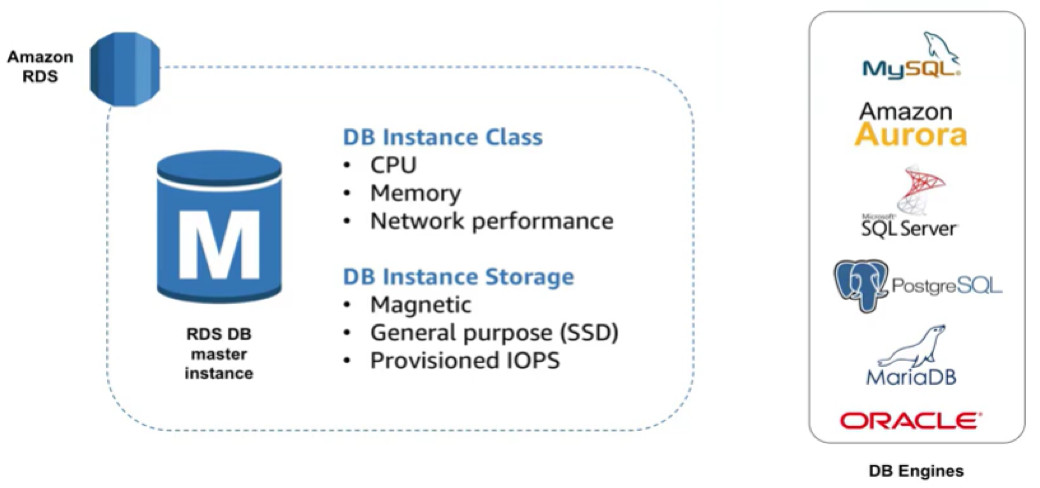
Amazon RDS DB Instances
Amazon
RDS
Amazon RDS
DB Instance Class
CPU
Memory
Network Performance
M
DB Instance Storage
RDS DB
master instance
Magnetic
General Purpose (SSD)
Provisioned IOPS
RDS DB
master instance
DB Engines
DB Engines

Slide 105
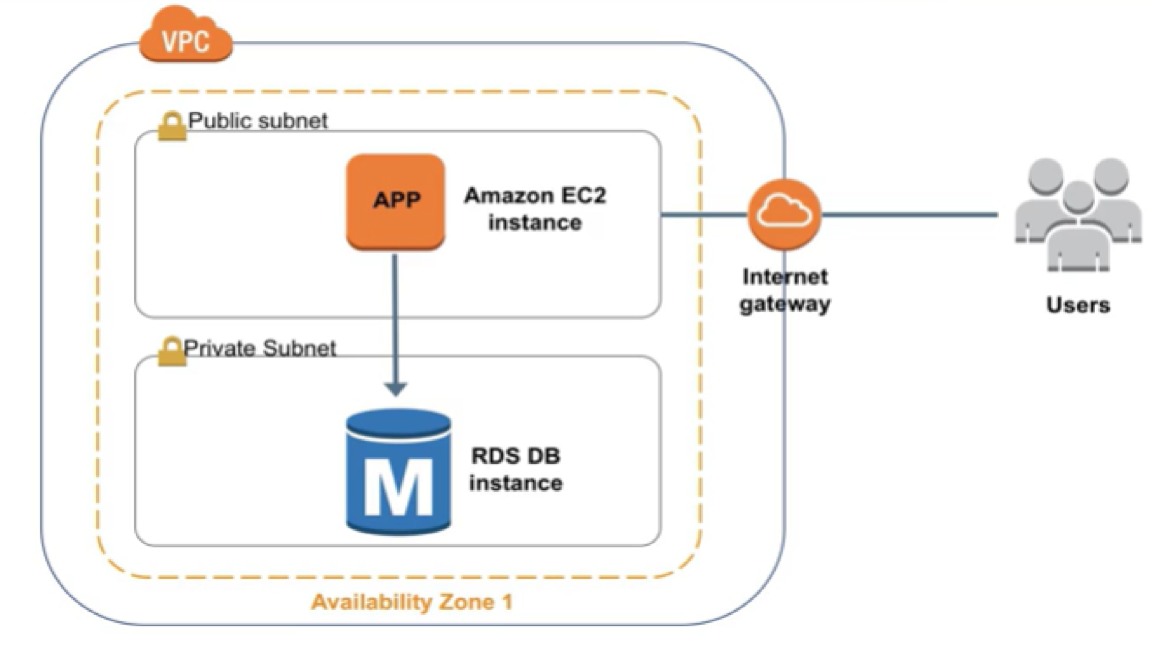


Amazon RDS In a Virtual Private Cloud
VPC
P
ublic subnet
Amazon
App
EC2
instance
internet
gateway
Users
P
rivate subnet
M
RDS DB
instance
Availability Zone 1

Slide 106
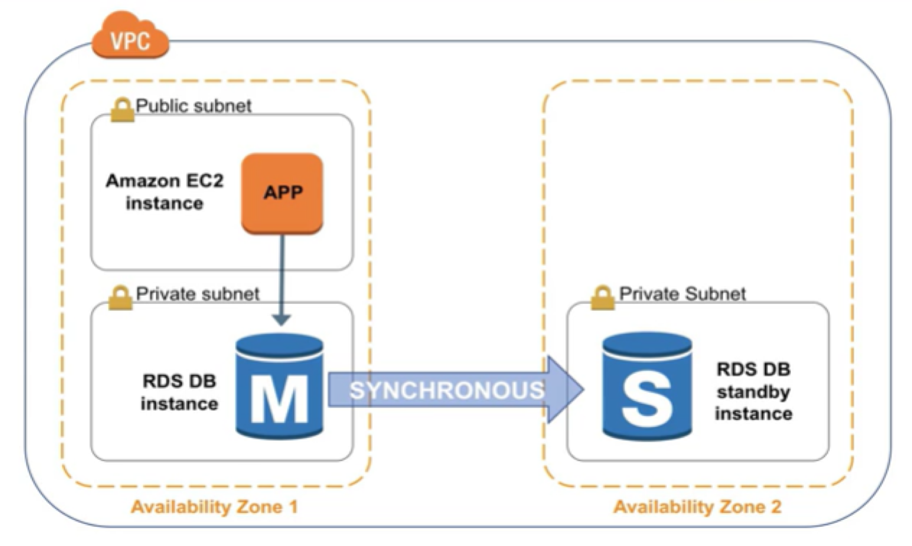
High Availability with Multi-AZ
VPC
P
ublic subnet
Amazon
EC2
instance
App
Private subnet
Private subnet
RDS DB
M
S
RDS DB
instance
SYNCHRONOUS
standby
instance
Availability Zone 1
Availability Zone 2

Slide 107
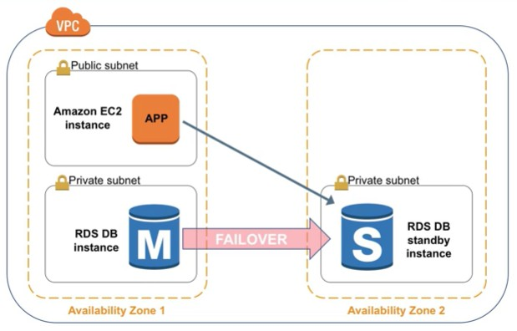
High Availability with Multi-AZ
VPC
P
ublic subnet
Amazon
EC2
instance
App
Private subnet
Private subnet
RDS DB
M
S
RDS DB
instance
FAILOVER
standby
instance
Availability Zone 1
Availability Zone 2

Slide 108
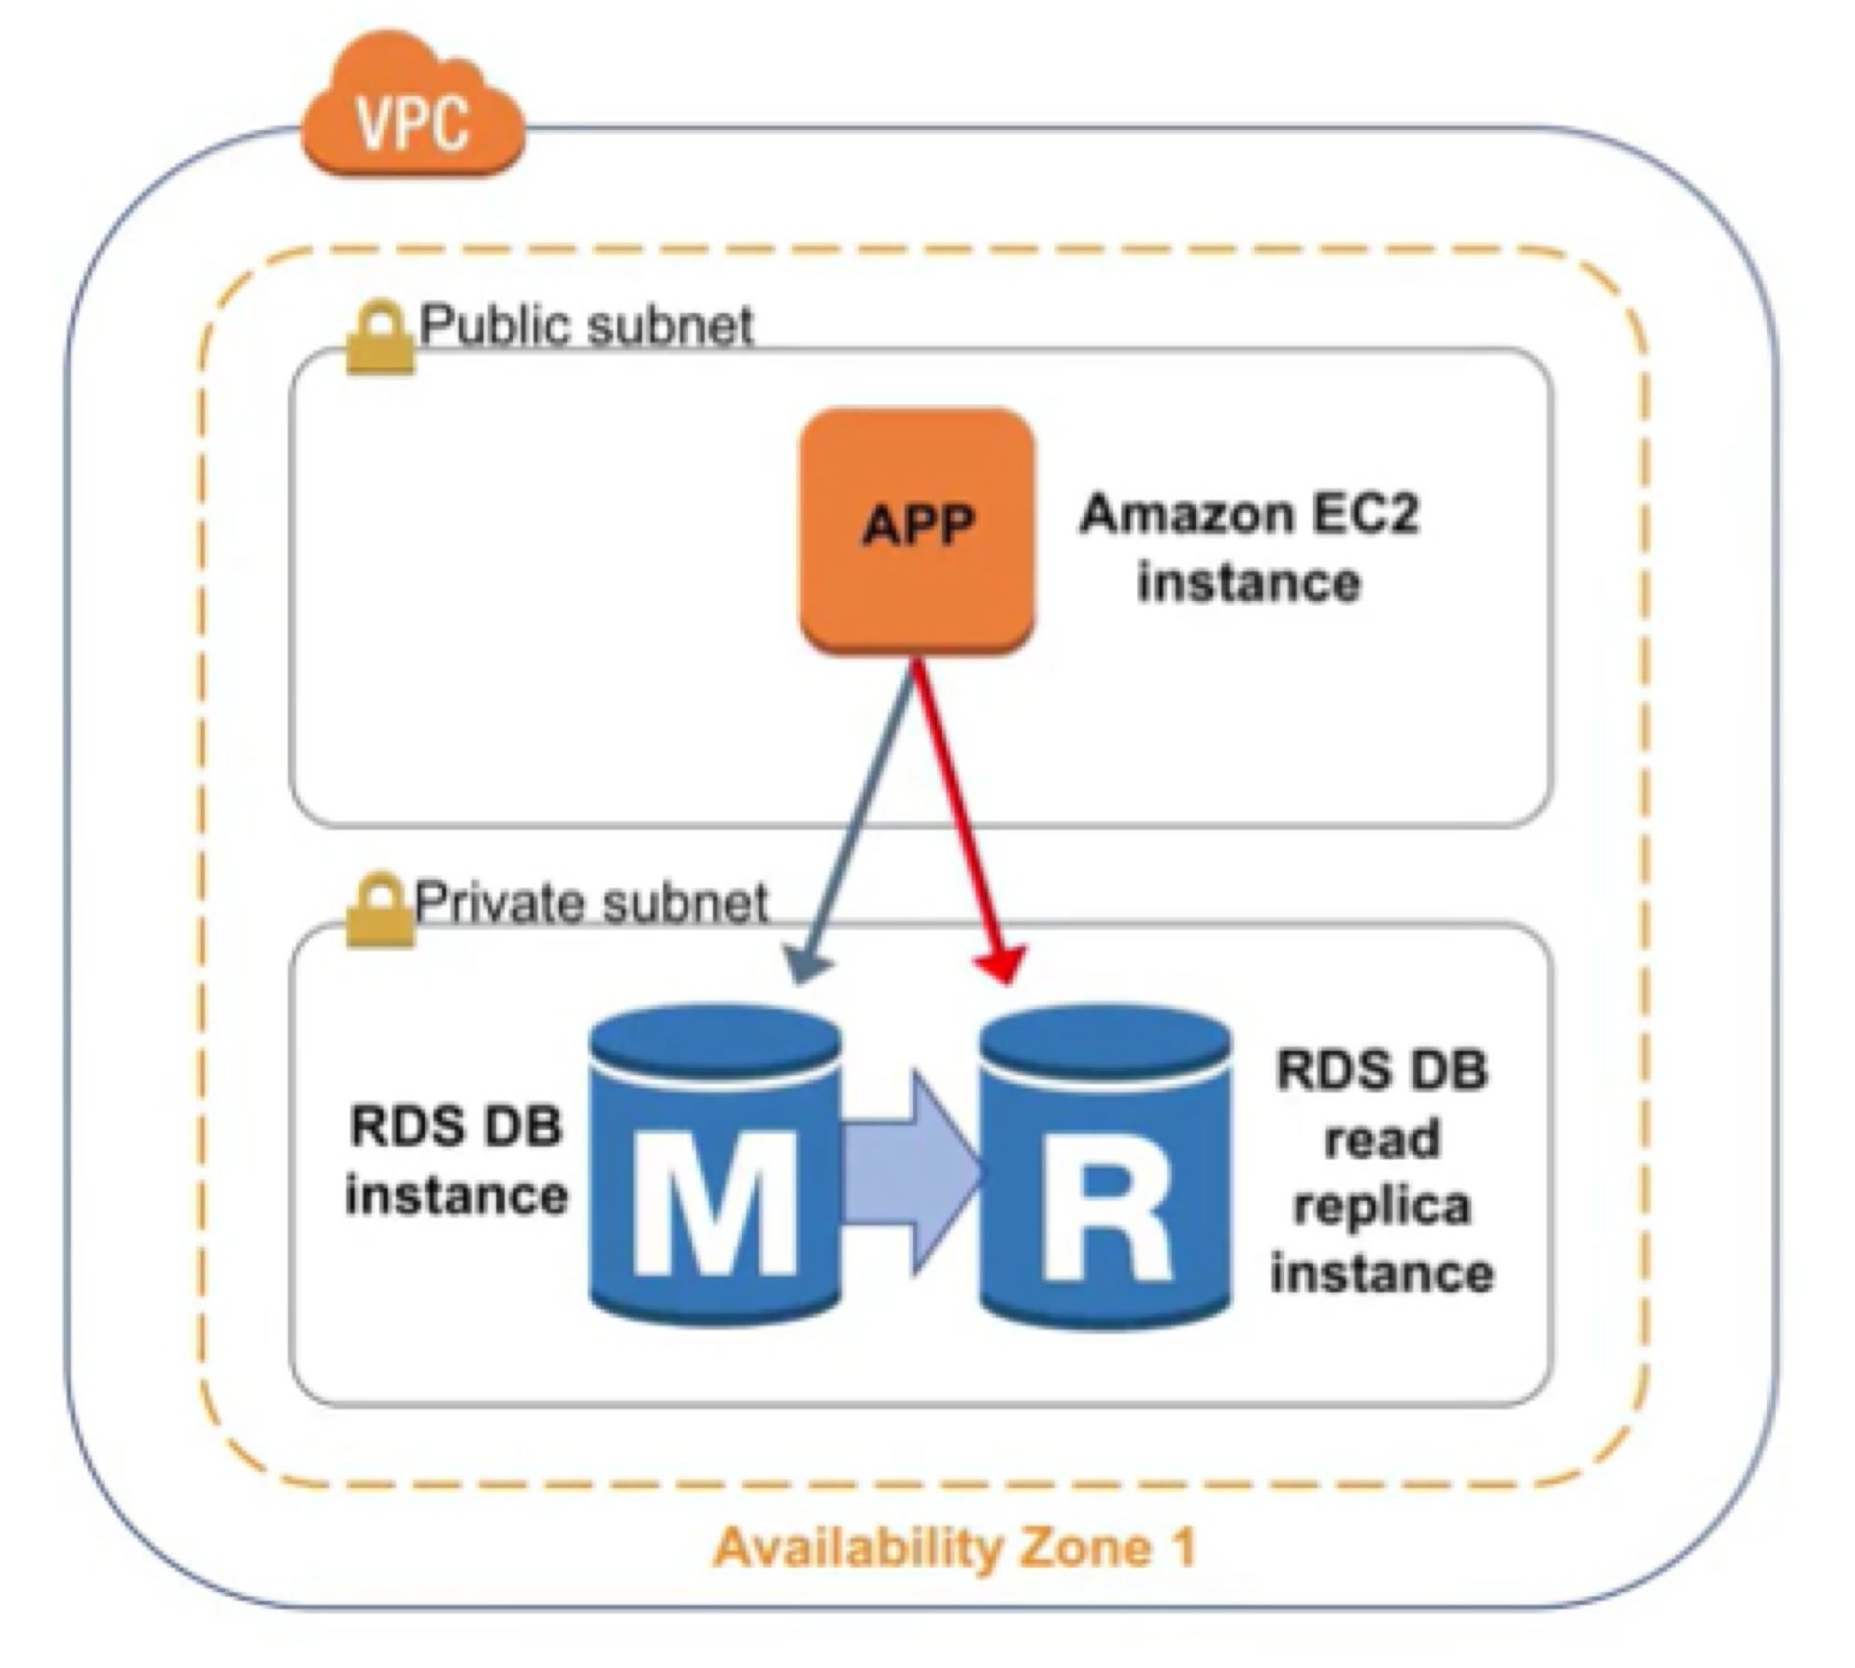
Amazon RDS Read Replicas
Features
Asynchronous replication Promote to master if necessary
VPC
P
ublic subnet
Amazon
App
EC2
instance
Functionality
Read-heavy database workloads Offload read queries
Private subnet
RDS DB
read replica instance
RDS DB
instance
M
R
Availability Zone 1

Slide 109
Use Cases
Web and Mobile Applications | üHigh throughput üMassive storage scalability üHigh availability
E-commerce Applications | üLow-cost database üData security üFully managed solution
Mobile and Online Games | üRapidly grow capacity üAutomatic scaling üDatabase monitoring

Slide 110
Summary
Highly scalable High performance Easy to administer
Available and durable Secure and compliant

Slide 111
Amazon DynamoDB

Slide 112
What Is Amazon DynamoDB?
NoSQL database tables Virtually unlimited storage
Items may have differing attributes Low-latency queries
Scalable read/write throughput

Slide 113
Common Use Cases
Web
Mobile apps Internet of Things Ad tech
Gaming

Slide 114
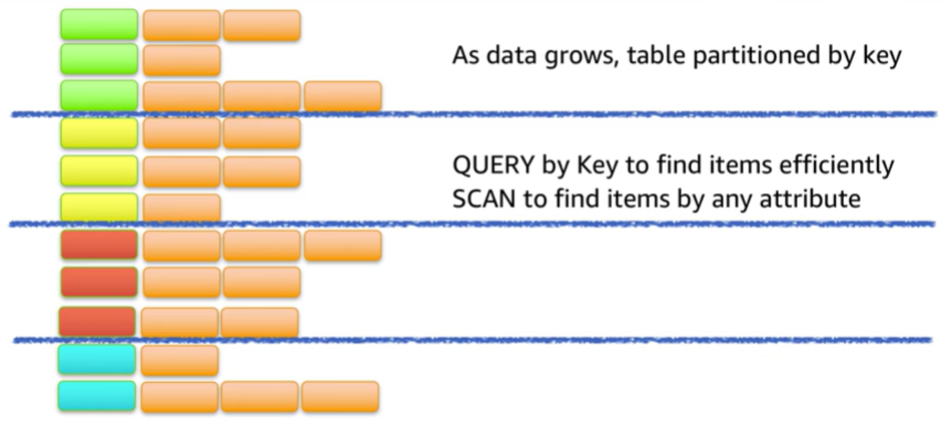
Partitioning

Slide 115
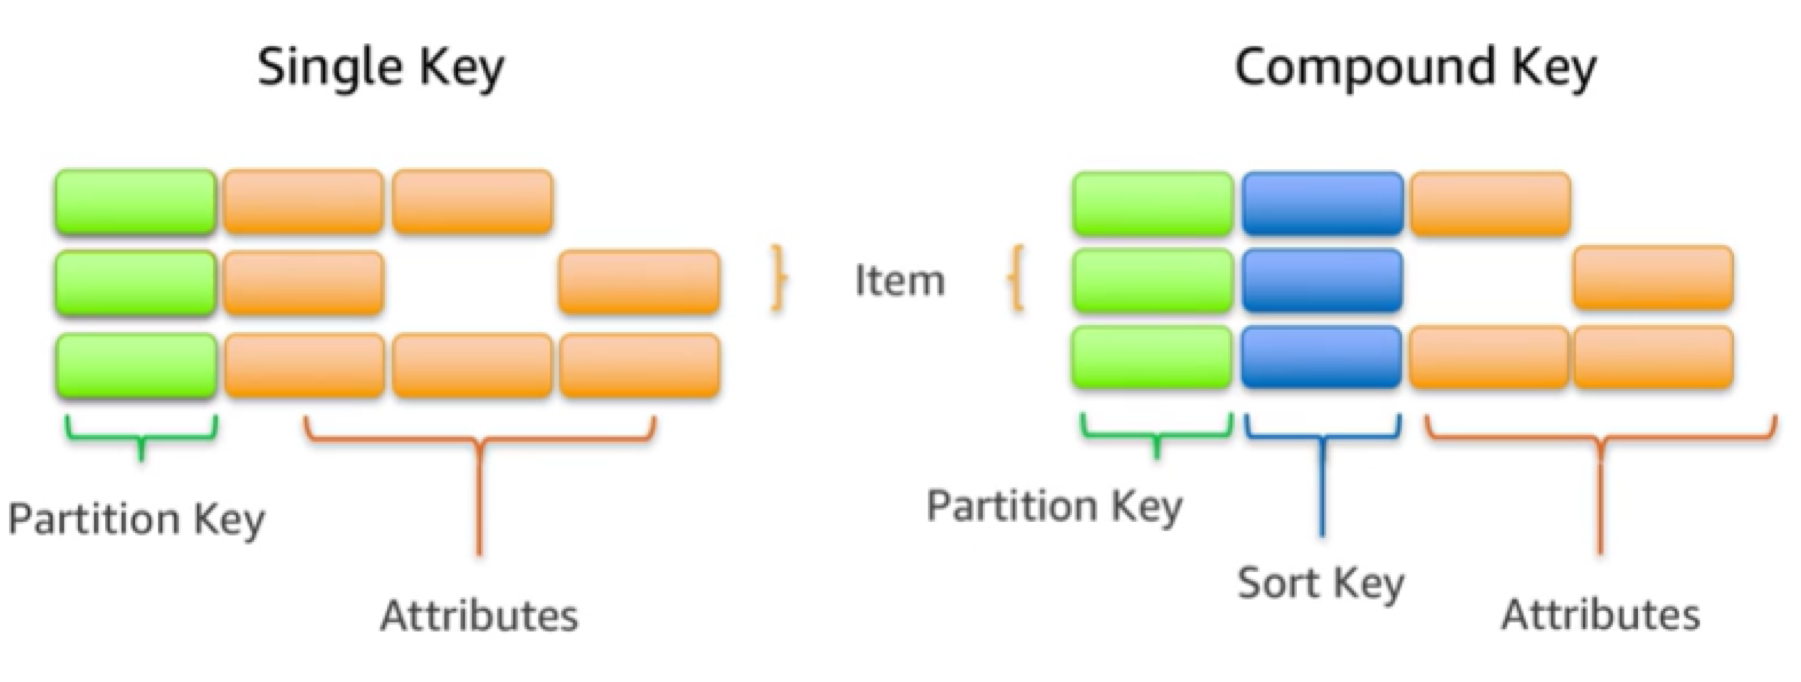
Items in a Table Must Have a Key

Slide 116
Summary
Managed NoSQL database service Data store for applications
P Store large amounts of data
P Support high request volume
P Require low-latency query performance

Slide 117
Module 3: Security Overview

Slide 118
Topics
Introduction to AWS Security
The AWS Shared Responsibility Model AWS Access Control and Management AWS Security Compliance Programs

Slide 119
Introduction to AWS Security

Slide 120
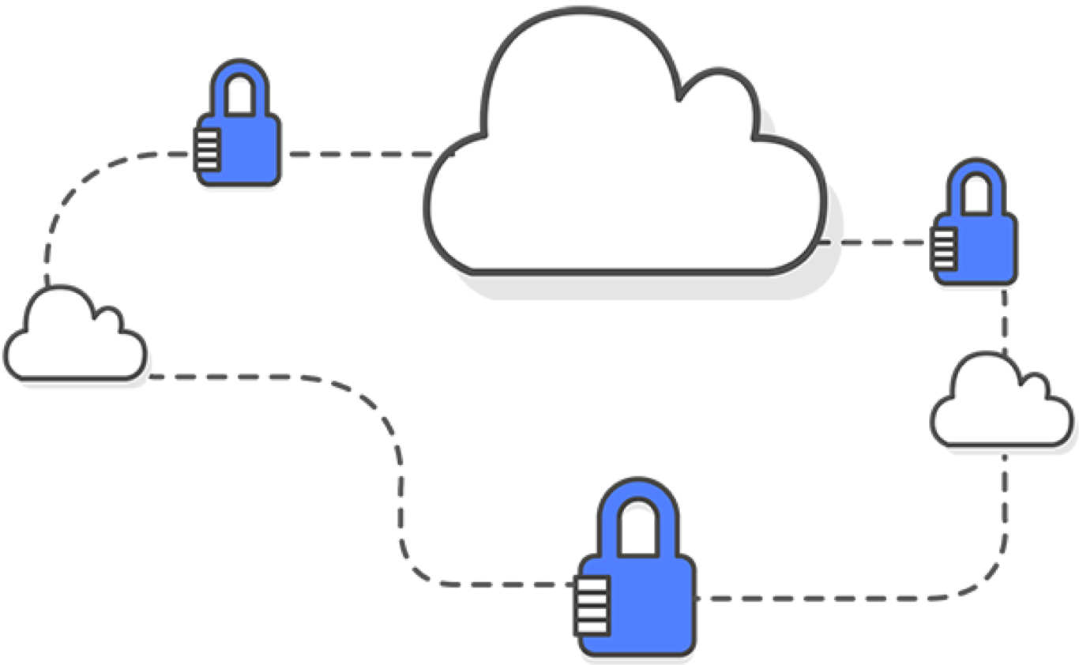
Introduction to AWS Security
Security is of the utmost importance to AWS.
Approach to security
AWS environment controls AWS offerings and features

Slide 121

Keep Your Data Safe
Resilient infrastructure High security
Strong safeguards

Slide 122
Continual Improvement
Rapid innovation
Constantly evolving security services

Slide 123

Pay For What You Need
Advanced security services Address real-time emerging risks
Meeting needs at a lower operational cost

Slide 124
Meet Compliance Requirements
Governance-enabled features
P Additional oversight
P Security control
P Central automation

Slide 125
AWS Shared Responsibility Model
Inherit AWS security controls Layer your controls

Slide 126

Security Products and Features
Tools
P Access from AWS and partners
P Use for monitoring and logging

Slide 127

Network Security
Built-in firewalls Encryption in transit
Private/dedicated connections
Distributed denial of service (DDoS) mitigation

Slide 128
Inventory and Configuration Management
Deployment tools
Inventory and configuration tools
Template definition and management tools

Slide 129


Data Encryption
Encryption capabilities Key management options
P AWS Key Management Service
Hardware-based cryptographic key storage options
P AWS CloudHSM

Slide 130
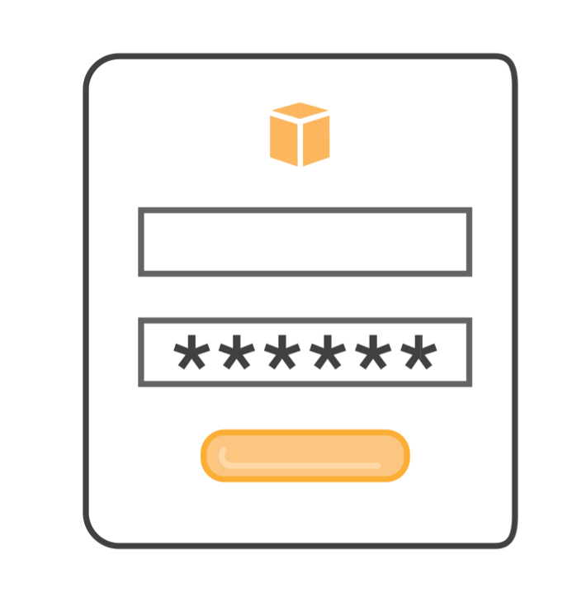
Access Control and Management
Identity and Access Management (IAM) Multi-factor authentication (MFA)
Integration and federation with corporate directories Amazon Cognito
AWS Single Sign-On

Slide 131

Monitoring and Logging
Tools and features to reduce your risk profile:
P Deep visibility into API calls P Log aggregation and options P Alert notifications

Slide 132
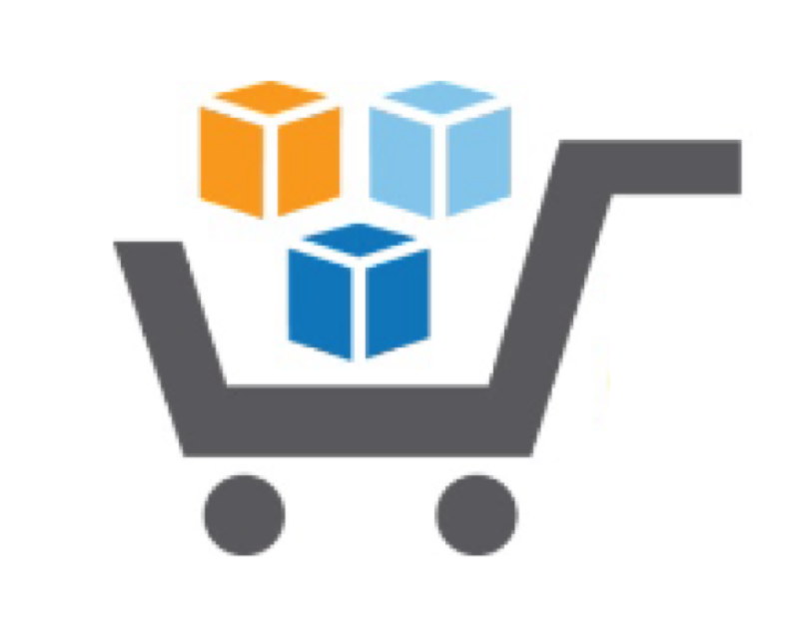
AWS Marketplace
Qualified partners to market/sell software to AWS customers
Online software store that can run on AWS

Slide 133
The AWS Shared Responsibility Model

Slide 134
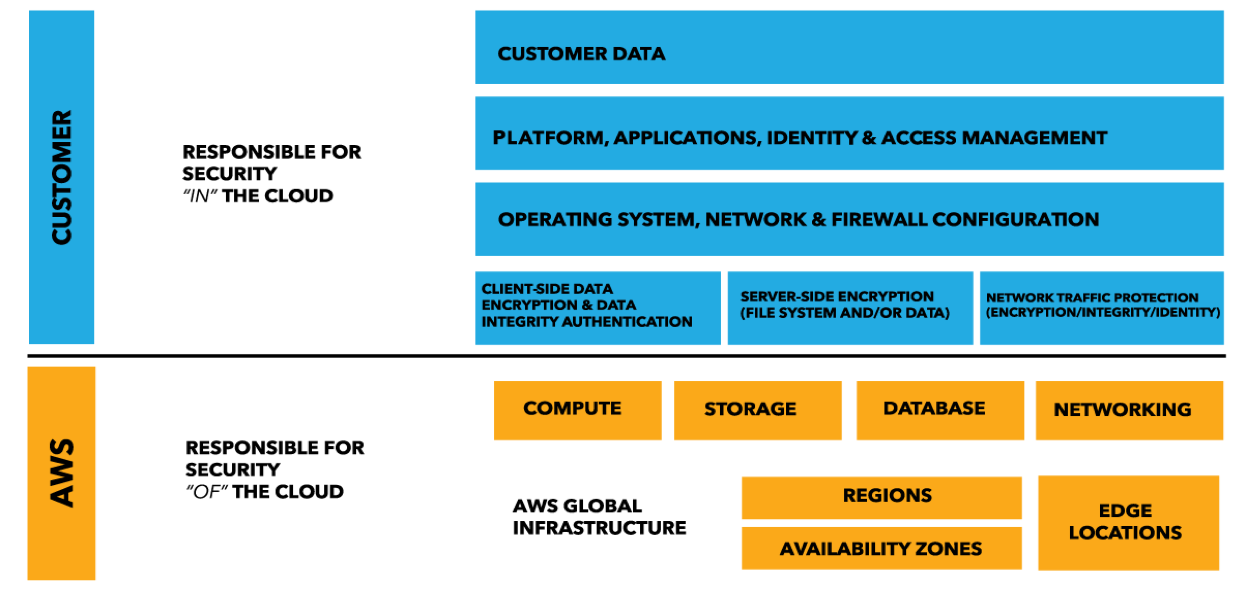
Shared Responsibility Model

Slide 135
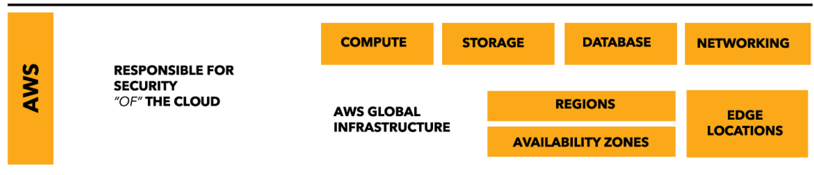
Security of the Cloud
Protection of the AWS global infrastructure is top priority Availability of third-party reports

Slide 136

Security of the Cloud
AWS Foundation Services
Managed Services
Amazon EC2 Amazon EBS
Amazon DynamoDB Amazon RDS Amazon Redshift Amazon EMR Amazon WorkSpaces

Slide 137
Security of the Cloud
AWS Foundation Services
Managed Services
Inherited Controls
P Physical
P Environmental
Shared Controls
P Patch Management
P Configuration Management
P Awareness and Training
Customer Specific
P Service/Communication Protection
P Zone Security

Slide 138
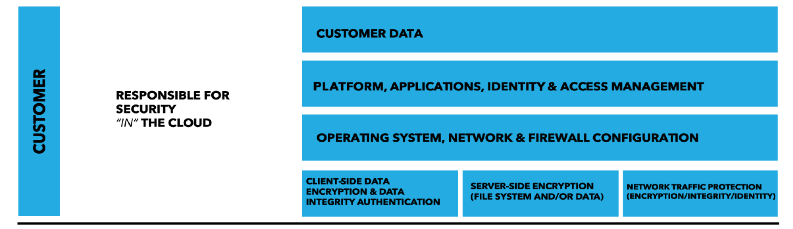
Security in the Cloud
What to store Which AWS services In what location
In what content format and structure
Who has access

Slide 139
Security in the Cloud
Customers retain control
Changes to model depend on services

Slide 140
Security in the Cloud
AWS Service Catalog Virtual Machine Images Servers
Software Databases

Slide 141
Security in the Cloud
Benefits
Centrally manage common IT services Achieve consistent governance
Meet compliance requirements Quickly deploy approved IT services

Slide 142
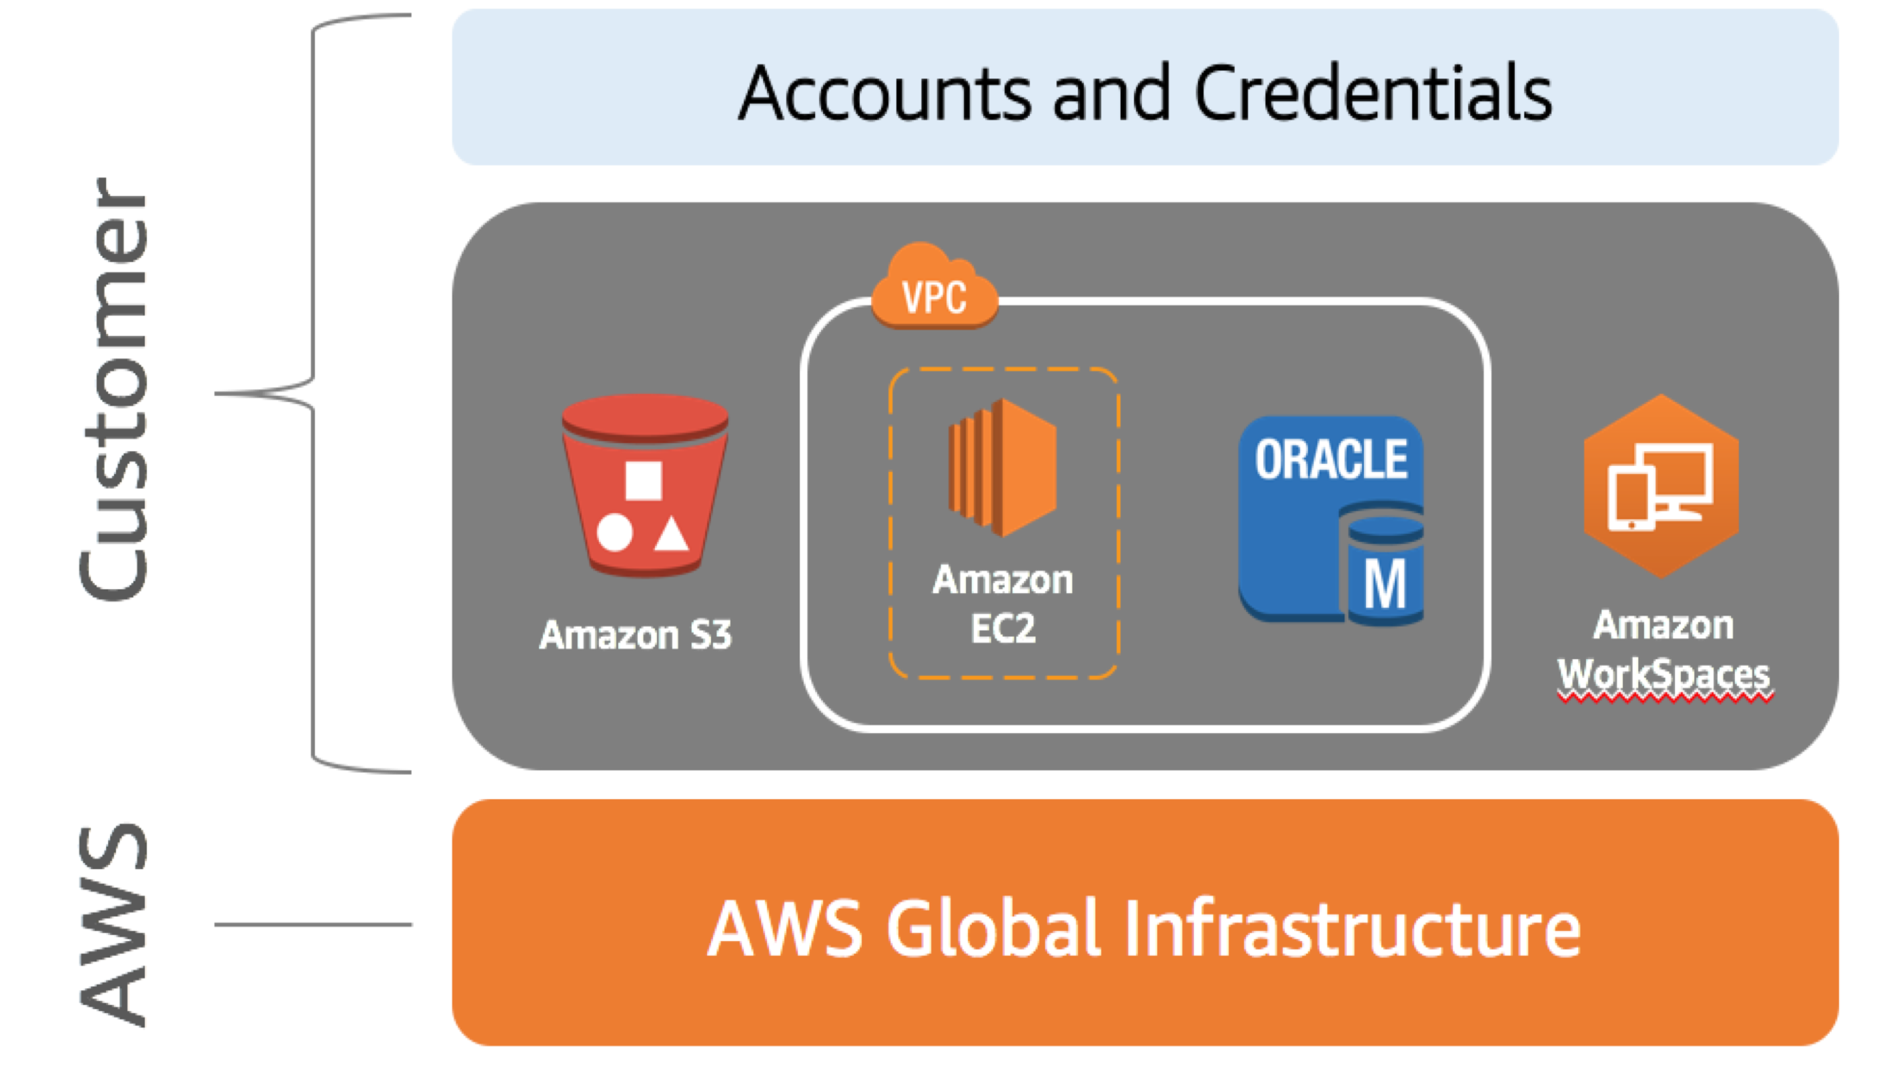
Example
Customer Responsibility:
P Guest OS
P Application
P Security group
Amazon
Amazon S3
EC2
Amazon
Workspaces

Slide 143
Summary
AWS and the customer share security responsibilities
P AWS: Security of the cloud
P Customer: Security in the cloud
Customer has full control over security measures Customer can use AWS Service Catalog “Infrastructure” Service

Slide 144
AWS Access Control and Management

Slide 145

AWS IAM
Control access to AWS resources
P Authentication
P Authorization
Controls access to services such as:
Compute Storage
Database Application services

Slide 146





AWS IAM
Create users and groups Grant permissions
User
Group
Permissions
Role

Slide 147



AWS IAM
Functionality
Manage
P Users and their access
P Roles and their permissions
P Federate users and their permissions
IAM
Corp

Slide 148
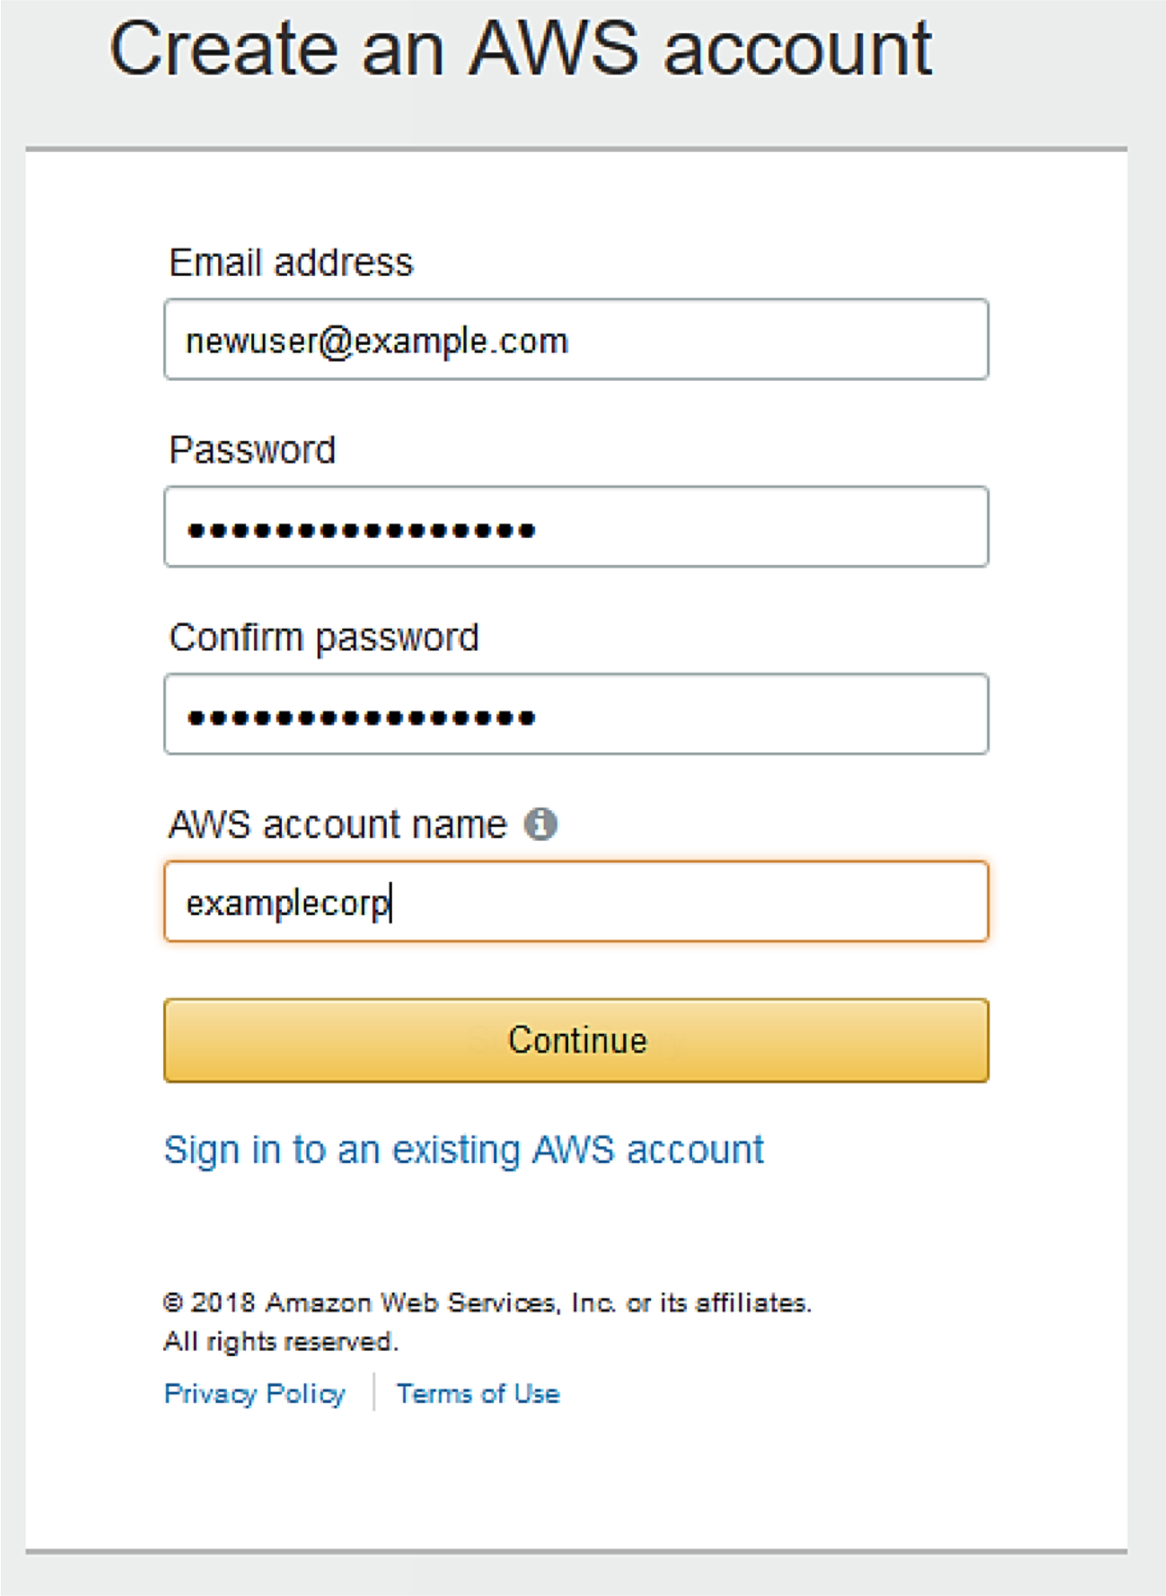
AWS Account Root User
Account root user has complete access to all AWS Services.

Slide 149





AWS Account Root User
Recommendations
Delete root user access keys.
Create an IAM user.
Grant administrator access.
Use IAM credentials to interact with AWS.
IAM

Slide 150



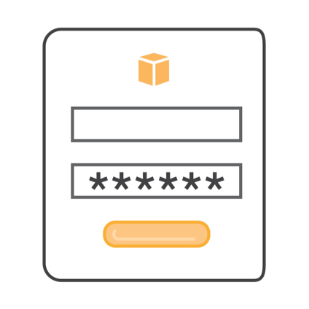
AWS IAM: Authentication
Programmatic access
P Enables access key ID and secret access key
Management console access
P Uses AWS account name and password
P MFA prompts for code

Slide 151




AWS IAM: Authorization
Access AWS services
P Grant authorization
Assign permissions
P Create an AWS IAM policy

Slide 152






AWS IAM: Policy Assignment
IAM Policy
IAM User
IAM Group
IAM Roles

Slide 153
IAM Best Practices
Delete AWS root account access keys Activate multi-factor authentication (MFA)
Give IAM users only the permissions they must have Use IAM groups
Apply an IAM password policy

Slide 154
IAM Best Practices
Roles
P Use roles for applications
P Use roles instead of sharing credentials
Credentials
P Rotate credentials regularly
P Remove unnecessary users and credentials Use policy conditions for extra security Monitor activity in your AWS account

Slide 155
AWS Security Compliance Programs

Slide 156
Overview
AWS compliance approach
AWS risk and compliance programs
AWS customer compliance responsibilities

Slide 157

AWS Compliance Approach
AWS and customers share control AWS responsibility
P Provide highly secure and controlled platform
P Provide wide array of security features
Customers responsibility
P Configure IT

Slide 158
AWS Security Information
AWS shares security information by Obtaining industry certifications Publishing security and control practices Compliance report directly under NDA

Slide 159
Assurance Programs
AWS, certifying bodies, and independent auditors Provide:
Certifications and attestations Laws, regulations, and privacy
Alignments and frameworks

Slide 160

AWS Risk and Compliance Programs
AWS risk and compliance programs Provide information about AWS controls
Assist customers in documenting their framework

Slide 161

AWS Risk and Compliance Programs
Components of AWS Risk and Compliance Programs
Risk management Control environment Information security

Slide 162
Risk Management
AWS management Business plan
P Includes risk management
P Re-evaluated at least biannually
Responsibilities
P Identifies risks
P Implements appropriate measures
P Assesses various internal/external risks

Slide 163
Risk Management
Information security network is based on
P Control Objectives for Information and related Technology (COBIT)
P American Institute of Certified Public Accountants (AICPA)
P National Institute of Standards and Technology (NIST)
RISK

Slide 164
Risk Management
AWS
Maintains the security policy
Provides security training to employees Performs application security reviews
P Confidentiality
P Integrity
P Availability of data
P Conformance to IS policy
RISK

Slide 165
Risk Management
AWS security
P Scan service endpoints for vulnerabilities
P Notifies for remediation of vulnerabilities
Independent security firms
P Scans are not a replacement for customer scans
P Customers can request to scan cloud infrastructure
RISK

Slide 166

Control Environment
Includes policies, processes, control activities
Secure delivery of AWS’ service offerings
Supports the operating effectiveness of AWS’ control framework
Integrates controls
Monitors for leading practices
control

Slide 167


Information Security
Designed to protect
P Confidentiality
P Integrity
P Availability
Publishes security whitepaper
security

Slide 168
Customer Compliance
Customer requirements
Maintain governance over the entire IT control environment
Understand
P Required compliance objectives P Validation based risk tolerance Establish control environment
Verify effectiveness of control environment

Slide 169
Summary
AWS security compliance programs
Enables customers to understand robust controls to maintain security and data protection
Shared compliance responsibilities

Slide 170
Module 4: AWS Architecting Essentials

Slide 171
Topics
Introduction to the Well-Architected Framework
Reference Architecture – Fault Tolerance and High Availability Reference Architecture: Web Hosting

Slide 172
Introduction to the Well- Architected Framework

Slide 173
Introduction
Assess and improve architectures
Understand how design decisions impact business Learn the five pillars and design principles

Slide 174
5 Pillars
Security Reliability
Performance efficiency Cost optimization
Operational excellence

Slide 175

Security Pillar
Identity and access management (IAM) Detective controls
Infrastructure protection Data protection
Incident response

Slide 176

Security Pillar: Design Principles
Implement security at all layers Enable traceability
Apply principle of least privilege Focus on securing your system
Automate

Slide 177
Reliability Pillar
Recover from issues/failures Apply best practices in:
P Foundations
P Change management
P Failure management
Anticipate, respond, and prevent failures

Slide 178
Reliability Pillar: Design Principles
Test recovery procedures Automatically recover Scale horizontally
Stop guessing capacity Manage change in automation

Slide 179

Performance Efficiency Pillar
Select customizable solutions Review to continually innovate Monitor AWS services Consider the trade-offs

Slide 180

Performance Efficiency Pillar: Design Principles
Democratize advanced technologies Go global in minutes
Use a serverless architectures Experiment more often
Have mechanical sympathy

Slide 181
Cost Optimization Pillar
Use cost-effective resources Matching supply with demand Increase expenditure awareness Optimize over time

Slide 182

Cost Optimization Pillar: Design Principles
Adopt a consumption model Measure overall efficiency
Reduce spending on data center operations Analyze and attribute expenditure
Use managed services

Slide 183
Operational Excellence Pillar
Manage and automate changes Respond to events
Define the standards

Slide 184
Summary
Five pillars and their associated design principles
P Security
P Reliability
P Performance Efficiency
P Cost Optimization
P Operational Excellence

Slide 185
Reference Architecture –
Fault Tolerance and High Availability

Slide 186
Fault Tolerance
Ability of a system to remain operational
Built-in redundancy of an application’s components

Slide 187

High Availability
High availability is designed to keep
Systems generally functioning and accessible Downtime minimized
Minimal human intervention required
Minimal up-front financial investment

Slide 188

High Availability: On Premises vs AWS
Traditional (on premises)
P Expensive
P Only mission-critical applications
AWS
P Multiple servers P Availability zones P Regions
P Fault-tolerant services

Slide 189
High Availability: AWS Services
AWS Services and High Availability
ü Amazon S3 and Amazon Glacier
DynamoDB
Amazon CloudFront
Amazon SWF
Amazon SQS ü Amazon SNS ü Amazon SES
Amazon Route53
Elastic Load Balancing
IAM
Amazon CloudWatch
Amazon CloudSearch
AWS Data Pipeline
Amazon Kinesis
Auto Scaling
Amazon Elastic File System
AWS CloudFormation
Amazon WorkMail
AWS Directory Service
AWS Lambda ü Amazon EBS ü Amazon RDS
Amazon EC2
Amazon VPC
Amazon Redshift
Amazon ElastiCache
AWS Direct Connect
*Not all services are listed here.
Inherently HA services
HA with the right architecture

Slide 190
High Availability Service Tools
Elastic load balancers Elastic IP addresses Amazon Route 53 Auto Scaling Amazon CloudWatch

Slide 191
Elastic Load Balancers
Distributes incoming traffic (loads) Sends metrics to Amazon CloudWatch Triggers and notifies
P High latency
P Over used

Slide 192
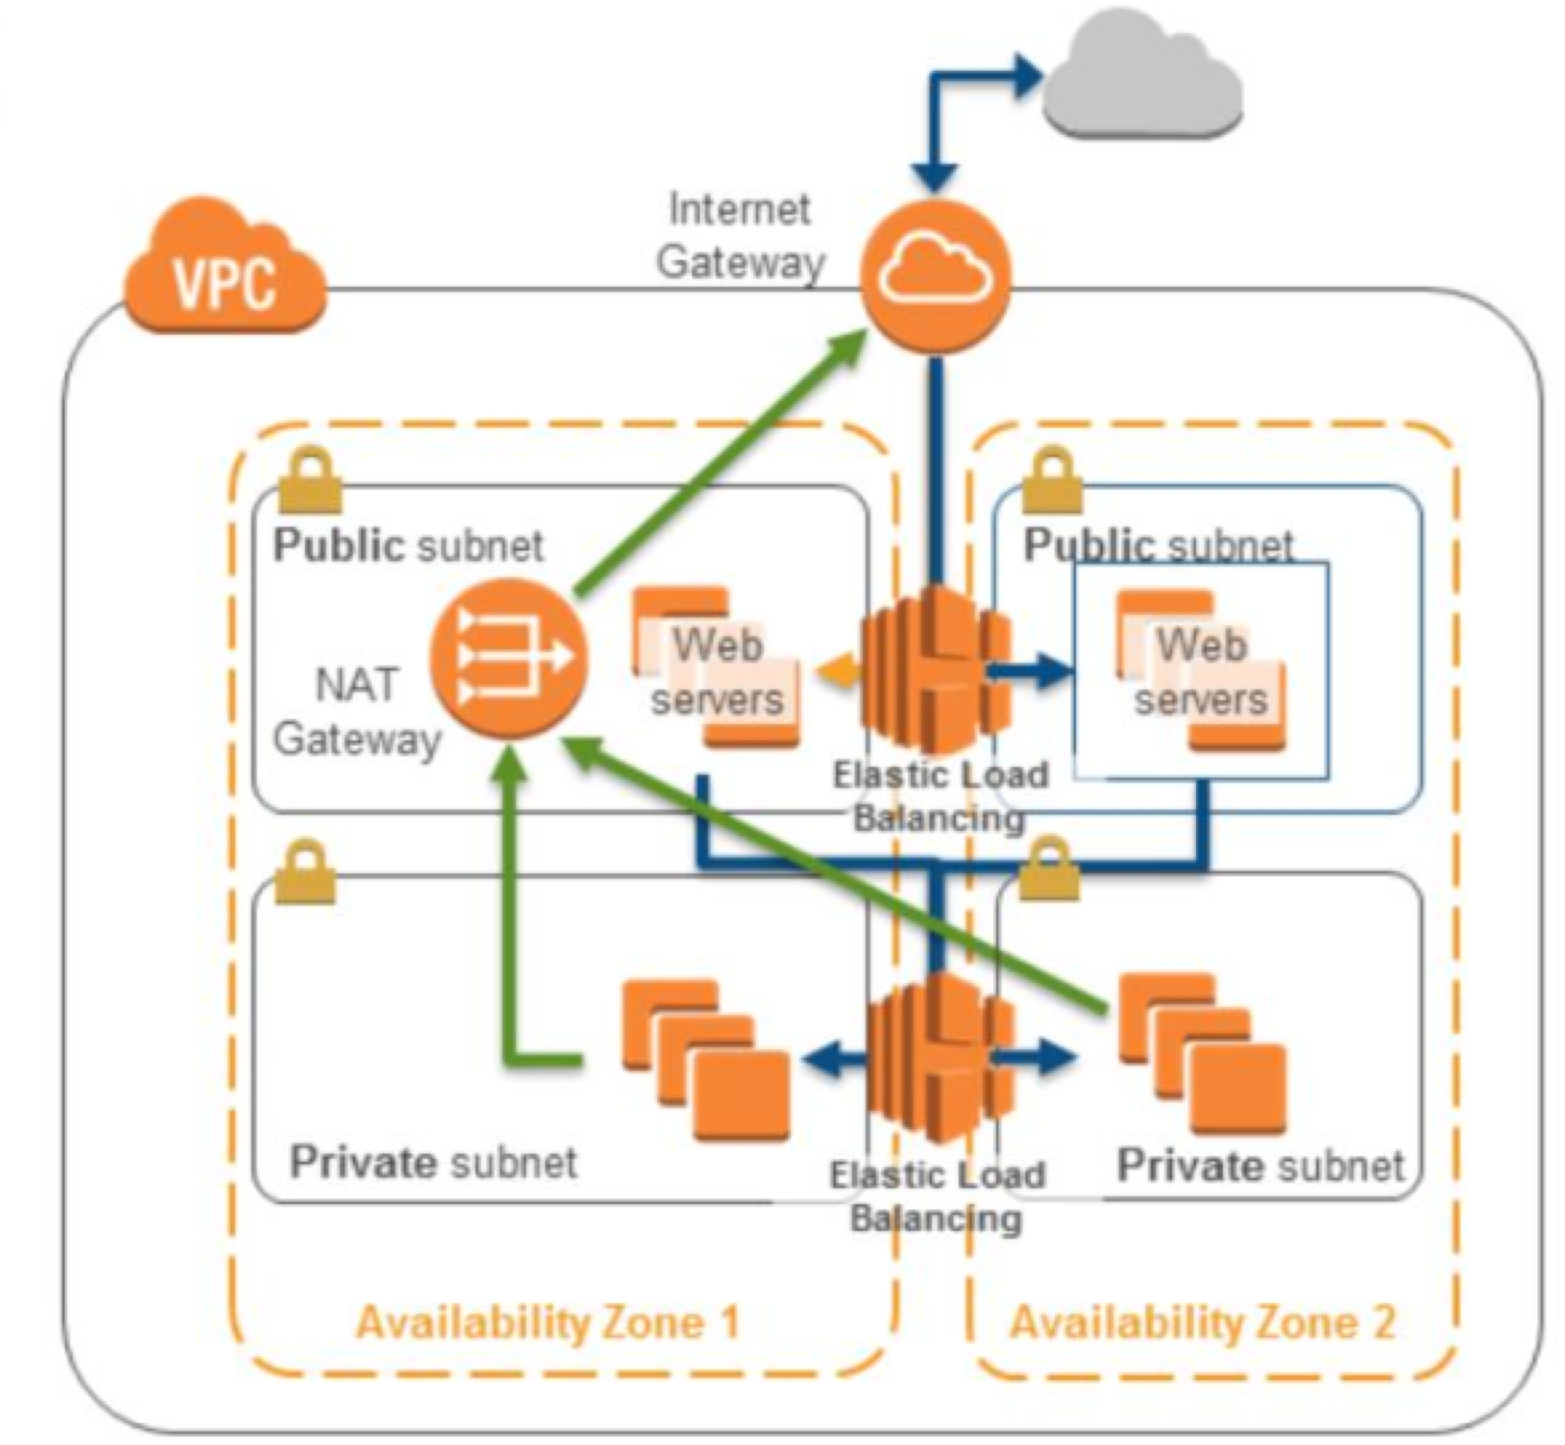
Elastic Load Balancers

Slide 193
Elastic IP Addresses
Are static IP addresses
Mask failures (if they were to occur)
Continues to access applications if an instance fails

Slide 194
Amazon Route 53
Authoritative DNS service
P Translates domain names to IP addresses
Supports:
P Simple routing
P Latency-based routing
P Health checks
P DNS failovers
P Geo-location routing

Slide 195

Auto Scaling
Terminates and launches instances
Assists with adjusting or modifying capacity Creates new resources on demand

Slide 196
Amazon CloudWatch
Alarm examples:
P If CPU utilization is >60% for 5 minutes…
P If number of simultaneous connections is >10 for one minute…
P If number of healthy hosts is <5 for 10 minutes…

Slide 197
Fault Tolerant Tools
Amazon Simple Queue Service Amazon Simple Storage Service Amazon SimpleDB
Amazon Relational Database Service

Slide 198
Summary
Fault Tolerant and highly available architectures Services to assist architectures

Slide 199
Reference Architecture: Web Hosting

Slide 200
Web Hosting
Web hosting on AWS:
P Fast
P Straightforward
P Low cost
Common web applications:
P Company website
P Content management system
P Social media application development
P Internal SharePoint site

Slide 201

Cost Effective Alternative
Leverage on-demand provisioning Eliminate wasted capacity
Continuously adjust to actual traffic patterns

Slide 202

Scalable
Handle unexpected traffic peaks or unexpected loads Launch new hosts in minutes
Scale hosts up or down

Slide 203
On-Demand Solution for Various Environments
Provision testing fleets Develop staging in minutes Simulate use traffic

Slide 204
Migrating to AWS: Web Hosting Services
Products to assist transition: P Amazon Virtual Private Cloud P Amazon Route 53
P Amazon CloudFront
P Elastic load balancing P Firewalls/AWS Shield P Auto Scaling
P App servers/EC2 instances
P Amazon ElastiCache
P Amazon RDS/Amazon DynamoDB

Slide 205

Key Architectural Considerations
Replace physical network appliances with software solutions Deploy firewalls everywhere
Make available multiple data centers
Build an ephemeral and dynamic architecture

Slide 206
Summary
AWS and web hosting AWS web hosted services
Key considerations for web hosted architectures

Slide 207
Module 5: Pricing Overview

Slide 208
Topics
Fundamentals of Pricing Pricing Details
Overview of the Total Cost of Ownership Calculator

Slide 209
Fundamentals of Pricing

Slide 210

AWS Pricing Model
Pay-as-you-go
Pay less when you reserve
Pay even less per unit by using more Pay even less as AWS grows

Slide 211
Pay-As-You-Go
Pay only for the services you consume, with no large upfront expenses.
Lower variable costs
Pay only as long as you need the service Adapt to changing business needs Redirect focus on innovation and invention

Slide 212
Pay Less When You Reserve
Invest in reserved instances
Save up to 75% Options
P All Upfront
P Partial Upfront
P No Upfront payments

Slide 213

Pay Less By Using More
Realize volume-based discounts Savings as usage increases
Tiered pricing for services (for example, Amazon S3, Amazon EC2)
No charge for inbound data transfer Storage services options

Slide 214

Pay Even Less as AWS Grows
As AWS grows
Focuses on lowering cost of doing business
Passes savings from economies of scale down to you

Slide 215
Custom Pricing
Meet varying needs through custom pricing
Available for high-volume projects with unique requirements

Slide 216

AWS Free Tier
AWS Free Tier helps customer get started in the cloud Limitations:
P Up to one year
P Certain services and options
For more details, see: https://www.aws.amazon.com/free

Slide 217
No Extra Charge
AWS services for no additional charge: Amazon VPC
AWS Elastic Beanstalk AWS CloudFormation
AWS IAM
Auto Scaling

Slide 218
Summary
Pay only for what you use Start and stop anytime
No long-term contracts required

Slide 219
Pricing Details

Slide 220
AWS Fundamentals
Pay for AWS fundamentals:
P Compute
P Storage
P Outbound data transfer
No charge:
P Inbound data transfer
Charge for aggregated outbound

Slide 221





Service Pricing for AWS Offerings
Amazon EC2
Amazon S3
Amazon EBS Amazon RDS Amazon CloudFront

Slide 222
Amazon EC2
Provide resizable compute capacity in the cloud
Allows the configuration of capacity with minimal friction Provides complete control
Charges only for capacity used

Slide 223
Amazon EC2: Billing and Instance Configuration
Clock-Second/Hourly Billing
Resources incur charges only when running
Instance Configuration
Physical capacity of the instance Pricing varies with:
P AWS region
P OS
P Instance Type
P Instance Size

Slide 224
Amazon EC2: Purchase Types
Ways to pay for Amazon EC2 instances
On-demand instances
P Compute capacity by the hour and second
P Minimum of 60 seconds
Reserved Instances
P Low or no up-front payment instances reserved
P Discount on hourly charge for that instance
Spot Instances
P Bid for unused Amazon EC2 capacity

Slide 225
Amazon EC2: Number of Instances and Load Balancing
Number of Instances
Provision multiple instances to handle peak loads
Load Balancing
Uses Elastic Load Balancing to distribute traffic Calculates monthly cost based on
P Hours load balancer runs
P Data load balancer processes

Slide 226
Amazon EC2: Monitoring
Use Amazon CloudWatch to monitor instances. Basic monitoring (default)
Detailed monitoring
P Fixed monthly rate
P Prorated partial months

Slide 227
Amazon EC2
Auto Scaling
Automatically adjusts number of instances Incurs no additional charge
Elastic IP Addresses
No charge for one Elastic IP address associated with a running instance.

Slide 228
Amazon EC2: OS and Software
Pricing for operating systems and software packages: Includes OS prices in instance prices
Partners with other vendors for certain software Requires licenses from vendors for other software
Brings existing license through specific vendor programs

Slide 229
Amazon S3: Storage Classes
Types of storage classes
Standard Storage
P 99.999999999% durability
P 99.99% availability
Standard-Infrequent Access (S-IA)
P 99.999999999% durability
P 99.9% availability

Slide 230
Amazon S3: Storage
Considerations for estimating storage cost
P The number and size of objects
P Type of storage

Slide 231
Amazon S3
Requests:
Pricing based on Number of requests Type of requests
P Different rates for GET requests
Data Transfer
Pricing based on the amount of data transferred out of the Amazon S3 region

Slide 232
Amazon EBS
Block-level storage for instances
EBS volumes persist independently from the instance Analogous to virtual disks in the cloud
Three volume types:
P General Purpose (SSD) P Provisioned IOPS (SSD) P Magnetic

Slide 233
Amazon EBS: Volumes and IOPS
Volumes
All volume types are charged by the amount provisioned per month
IOPS
General Purpose (SSD)
P Included in price
Magnetic
P Charged by the number of requests
Provisioned IOPS (SSD)
P Charged by the amount you provision in IOPS

Slide 234
Amazon EBS: Snapshots and Data Transfer
Snapshots
Added cost of EBS snapshots to Amazon S3 is per GB-month of data stored
Data Transfer
Inbound data transfer has no charge Outbound data transfer charges are tiered

Slide 235
Amazon RDS
Relational database in the cloud Cost-efficient and resizable capacity
Management of time-consuming administrative tasks

Slide 236
Amazon RDS: Clock-Hour Billing and Database Characteristics
Clock-Hour Billing
Resources incur charges when running
Database Characteristics
Physical capacity of database:
P Engine
P Instance Type
P Instance Size

Slide 237
Amazon RDS: DB Purchase Type and Multiple DB Instances
DB Purchase Type
On-demand database instances
P By the hour
Reserved database instances
P Up-front payment for database instances reserved
Multiple DB Instances
Provision multiple DB instances to handle peak loads

Slide 238
Amazon RDS: Storage
Provisioned Storage
No charge
P Backup storage of up to 100% of database storage
Charge (GB/month)
P Backup storage for terminated DB instances
Additional Storage
Charge (GB/month)
P Backup storage in addition to provisioned storage

Slide 239
Amazon RDS: Deployment Type and Data Transfer
Storage and I/O charges vary depending on deployment type
Single Availability Zones Multiple Availability Zones
Data Transfer
No charge for Inbound data transfer Tiered charges for outbound data transfer

Slide 240
Amazon CloudFront
Web service for content delivery Integration with other AWS services
P Low latency
P High data transfer speeds
P No minimum commitments

Slide 241
Amazon CloudFront: Traffic Distribution
Pricing
Vary across geographic regions

Slide 242
Amazon CloudFront: Requests and Data Transfer Out
Requests
Pricing based on Number/type of requests Geographic region
Data Transfer Out
Pricing is based on the amount of data transferred out of Amazon CloudFront edge locations

Slide 243
Summary
Fundamental characteristics of product Estimate usage
Map usage to prices

Slide 244
Overview of the Total Cost of Ownership Calculator

Slide 245
AWS TCO Calculator
Use the TCO calculator to Estimate cost savings Use detailed reports Modify assumptions
Accessing the TCO Calculator:
https://awstcocalculator.com

Slide 246
Summary
Estimate cost savings
Use detailed set of reports
Modify assumptions for business needs

